Slide 1
Crossing Borders in Higher Education
Empowerment Through Internationalized eLearning

Slide 2
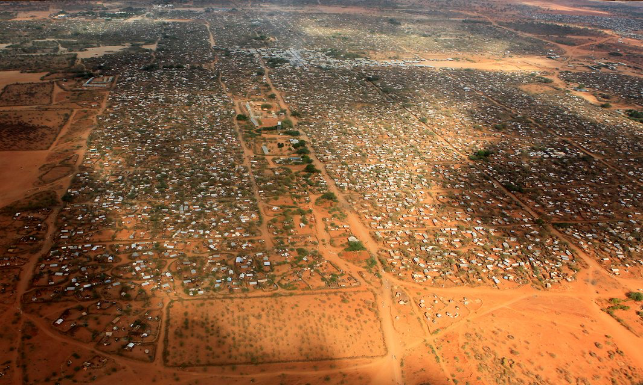
Writing Out of Life Experience
Creating a space where student-writers reflect on their own life as part of the writing process engenders a deeper investment in the act of writing.

Slide 3
Online Forum Activities
There were two types of online forum activities:
  Discussion Forums: discussions related to lecture and reading material for which specific prompts were provided
  Writing Activity Forums: forums in which students posted writing based on an assigned writing activity
  Although some discussion topics elicited exchanges between the Dadaab students and the Toronto students, the writing activities produced the most direct exchanges
  Furthermore, out of the discussion topics, those most related to personal writing practices generated the most exchange
  This difference does not indicate a lack of individual student engagement with other discussion topics

Slide 4
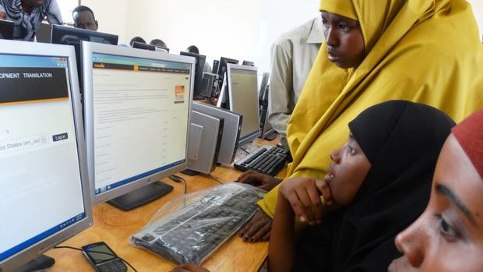
A Few Statistics
Discussion Forums: 17
Discussion topics which elicited exchanges between Toronto and Dadaab: 9/17
Discussion topics which included prompts to reflect on one’s own writing, learner-centred writing componants: 6/17
Writing Activities forums: 5
Wrtiing activitis that elcited exchanges between Toronto and Dadaab: 4/5

Slide 5
“Forums like this one that we are using are amazing because we are able to interact with people from all over the world and gain incredible insight! Thank you for sharing your thoughts”
Hello ---- i agree with you that every body has specific place and every society has it is own culture as i have captured from your words you used to dance during your free time but mine is different from you, because if Somali parents see their children dancing they face a lot of trouble thanks for your discussion.
Hi ----Your memory really reflects mostly positive past events. However, the way you crossed the bridge to adulthood was a bit challenging. Thanks that you can now manage your life. More importantly, you were better than me who never new what a radio was, in my childhood. I enjoyed traditional songs and dances.
You had a quite interesting environment at your childhood. This is not like mine where family vehicles is a rare thing and children, like us, move on foot to visit our relatives. We enjoy the natural songs of birds, insects, animals and plants when disturbed by wind. One thing I fully agree with you is the sustainability of our childhood memories and things that we relate to then. So for me, I have to think about the lives of those birds, animals, insects and plants.
Wow, you did such an incredible job telling this [factual] story! The way you chose to phrase your sentences made it feel as though you were telling the story orally and I could see where you were taking your breath, and when you slow down/speed up. You have a gift…Thanks for sharing.

Slide 6
Considering Ecocompostion
“The prefix ‘eco’ must not be misrepresented as simply ‘environmental’ as it often is, but instead must be understood specifically as a study of relationships. Ecocomposition is not ‘writing about trees’; ecocomposition is the study of written discourse and its relationships to the places in which it is situated and situates” (Sidney I. Dobrin and Christian R. Weisser, Natural Discourse: Toward Ecocomposition 2002).

Slide 7
Writing: Process of Relationships
“Ecocomposition recognizes the forces acting upon a writer and acknowledges that through writing the writer in turn influences those forces. Writing is a dynamic process of navigating relationships between writer, audience, and issue, with writer and these environmental forces equally acting upon each other” (Peter Wayne Moe, “Composition: Ecocomposition, Aristotle, and the First-Year Writing Course” 2011).

Slide 8
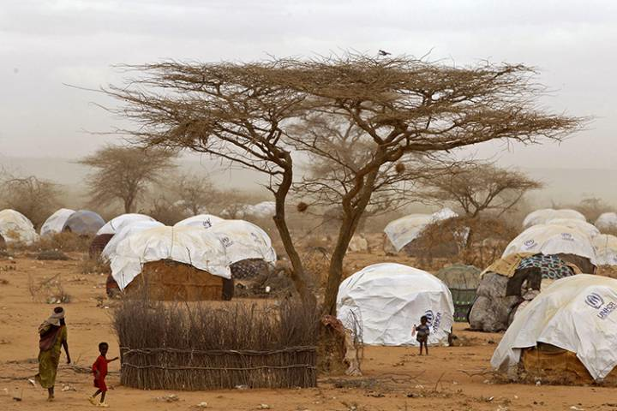
Writing a Memory of Place —
Acacia tree

Slide 9
Writing a Memory of Place —
Acacia tree
The acacia tree at our homestead has long-lasting connection in myself and endures in my memories vividly. The acacia is perennial tree that grows in the tropics and arid lands in Africa and may be elsewhere in the globe. This particular acacia grew at our homestead at Dagahaley and it is probably tens of years old. We found it there when we settled at that particular place that had become our homestead for almost two and half decades. With peers, we used to play under this trees a popular childhood game called “Aay-aay” where we collect pellets and put in a small shallow hole and move in-out the pellets in a systematic and swift manner, and repeating the whole process every now and then. This game was very interesting and very attractive. Surprisingly, every person in this community or locality must have played and liked this game once in their childhood.
Writing about this makes me vividly remember my earlier childhood days and the setting of that environment of those days. It reminds me of very best childhood friends I loved to play with us- friends that are no more in my reach, they are either deceased or gone far out of sight and reach……

Slide 10
The Value of Writing
“Writing can liberate us psychologically . . . . Personally as a refugee, I have seen and found that I a part of the world through this “WRIT COURSE”. Being a refugee for so long is really dehumanizing. One loses senses of surviving through a normal life. But by talking about it as I am now doing, I feel better and am able to appreciate myself as a worthy human being”

Slide 11
Multisite Blended
Learning

Slide 12
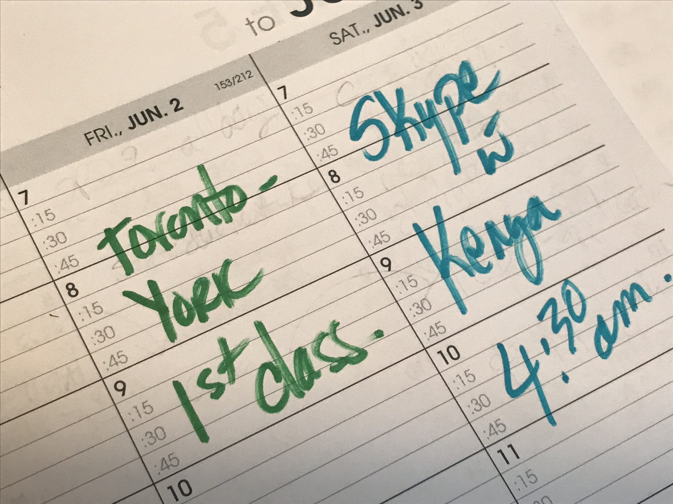
Multisite Blended Learning
Notes:
To remind you here’s the course schedule:
Friday -- Toronto face to face classes at York University
Saturday – Kenyan students attended the learning centre with on site support staff,
and the Toronto based teaching team connecting via Skype at the end of their day in Kenya.
We needed to end our live class, by 8:45 Saturday Morning.
2 - 3:45 in Kenya
Means 7 – 8:45 am Saturday
Starting at 5 Alberta Time.

Slide 13
Pre & Post Course Surveys
26 Toronto Based Learners
  Pre Survey
    19 paired to post
    5 unpaired
    24 completed
  Post Survey
    19 paired to pre
    3 unpaired
    22 completed
Notes:
We administered a pre and post course questionnaire to the all the Toronto based learners (26) and none of the Kenyan Camp based learners (25). Why only them? (1) Following INEE voluntary standards, we chose to not ask the Kenyan based learners to engage in any extra activities that were purely for research and not a curriculum driven learning activity. The INEE is International Network for Educators in Emergencies.
(2) We presume there is a clear value to the Kenyan based learners to access this course through this design, blended learning, with classmates in another country.
We had no evidence to support a presumption that there is value to Toronto based learners to engage in this curriculum through this course design.
This was a straight forward way to gather evidence on their perspective of this experience.

Slide 14
First Reaction
Unsettled
  Openness of the course structure.
  Use of moodle and WhatsApp.
Once they talked it out, they were:
  Cautiously enthusiastic.
Notes:
Their responses will provide the structure to my narrative.

Slide 15
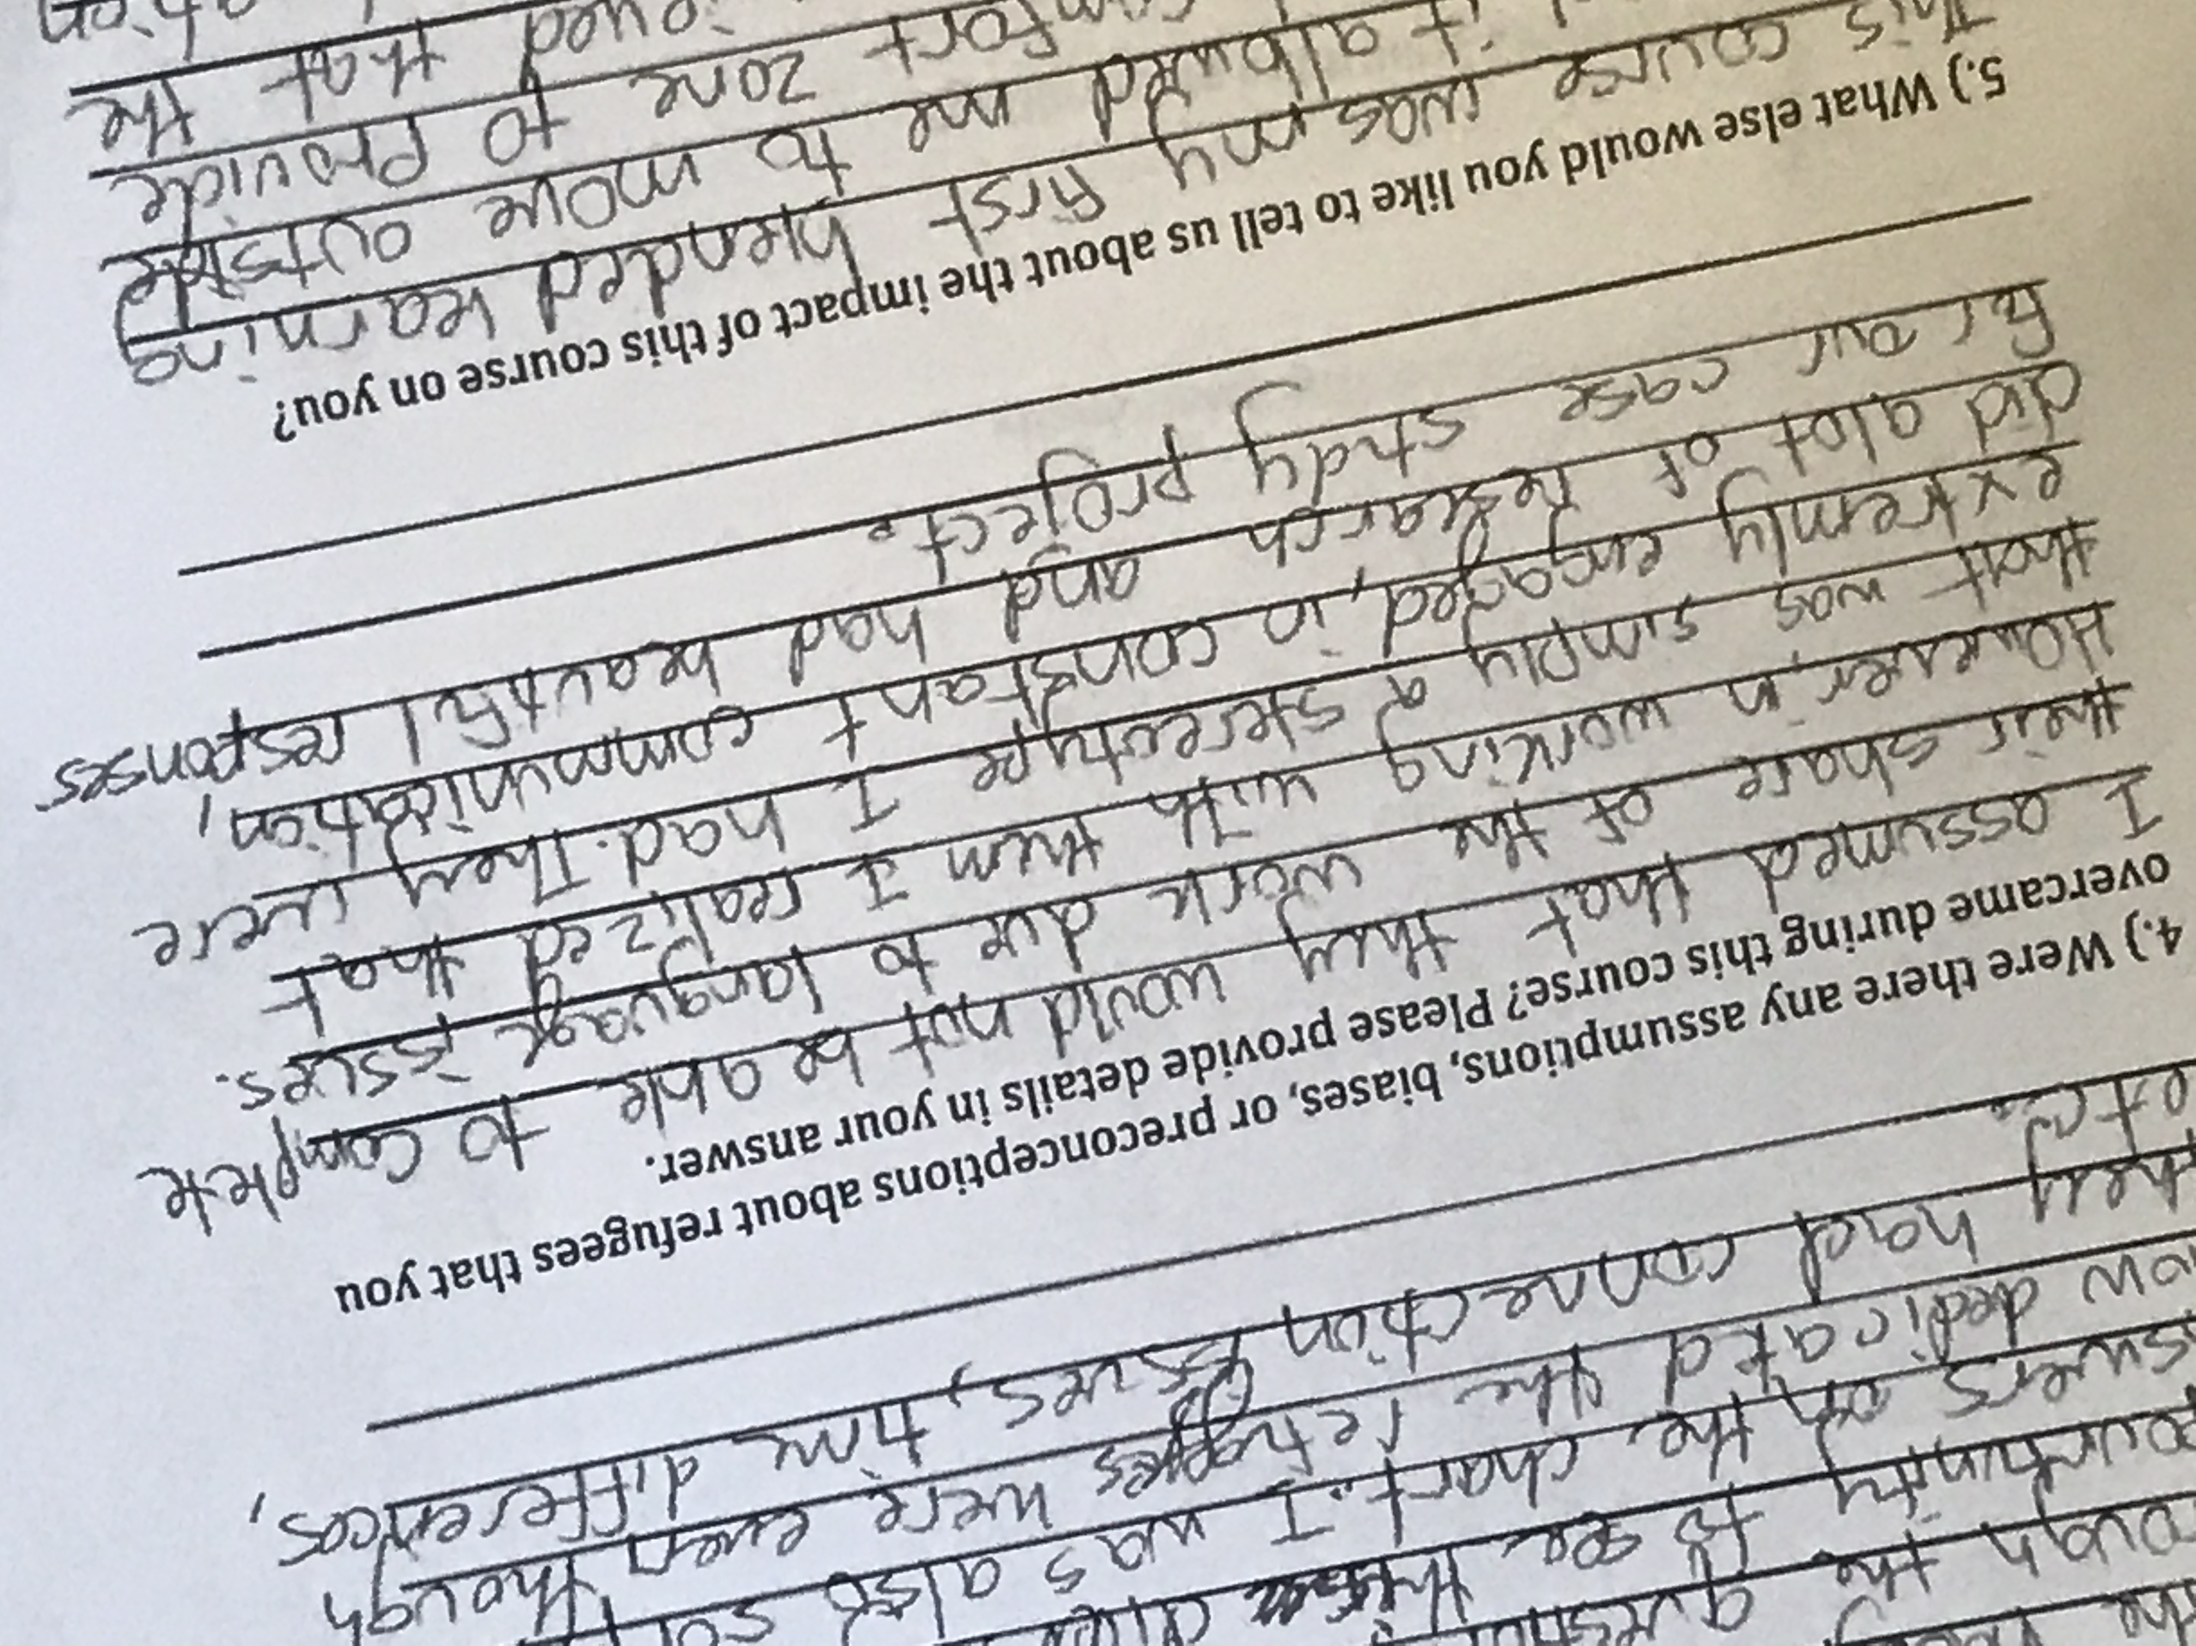
Overcoming Bias
Notes:
By the end of the course
the Toronto learners acknowledged a variety of personal biases.

Slide 16
Component of the Redesign
International mix for group assignment.
Each group had learners from Canada and Kenya.
Notes:
An important component in the redesign was to compose the groups for the case study assignment
With learners from both geographies
We could do this
because we we had a reasonable expectation
that using WhatsApp
would provide enough opportunity for learners
to collaborate asynchronously.

Slide 17
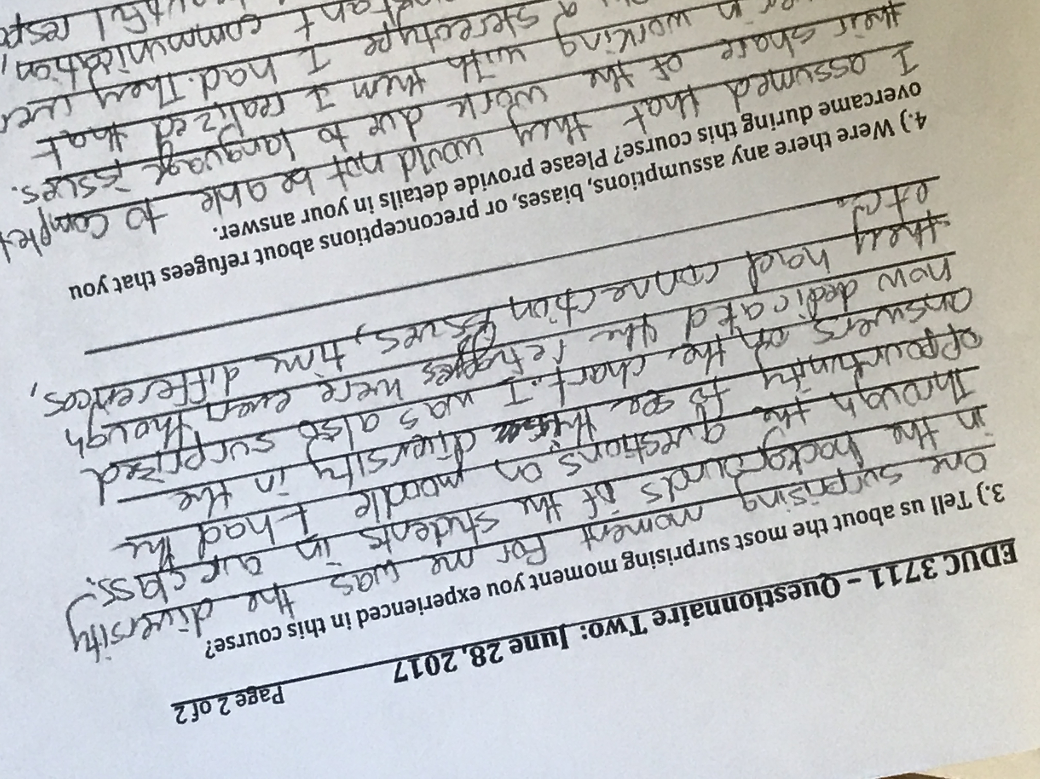
Learners’ Views
Notes:
This learner reflected on the increase in awareness of the diversity of backgrounds of the learners based on the Moodle Poll questions.

Slide 18
Component of the Redesign
Poll Questions (called “Choices” in moodle)
  Release one question at a time.
  Multiple choice.
  No right or wrong answer.
  Aggregated anonymous responses were visible only after the user responded.
Notes:
Here’s what we did.
We created a series of short poll questions.
Released one question at a time, staggered throughout the course.
Always multiple choice
No right or wrong answer
The aggregated anonymous responses were visible only after the user responded.
So no online lurking of the poll results. To see them they had to participate.

Slide 19
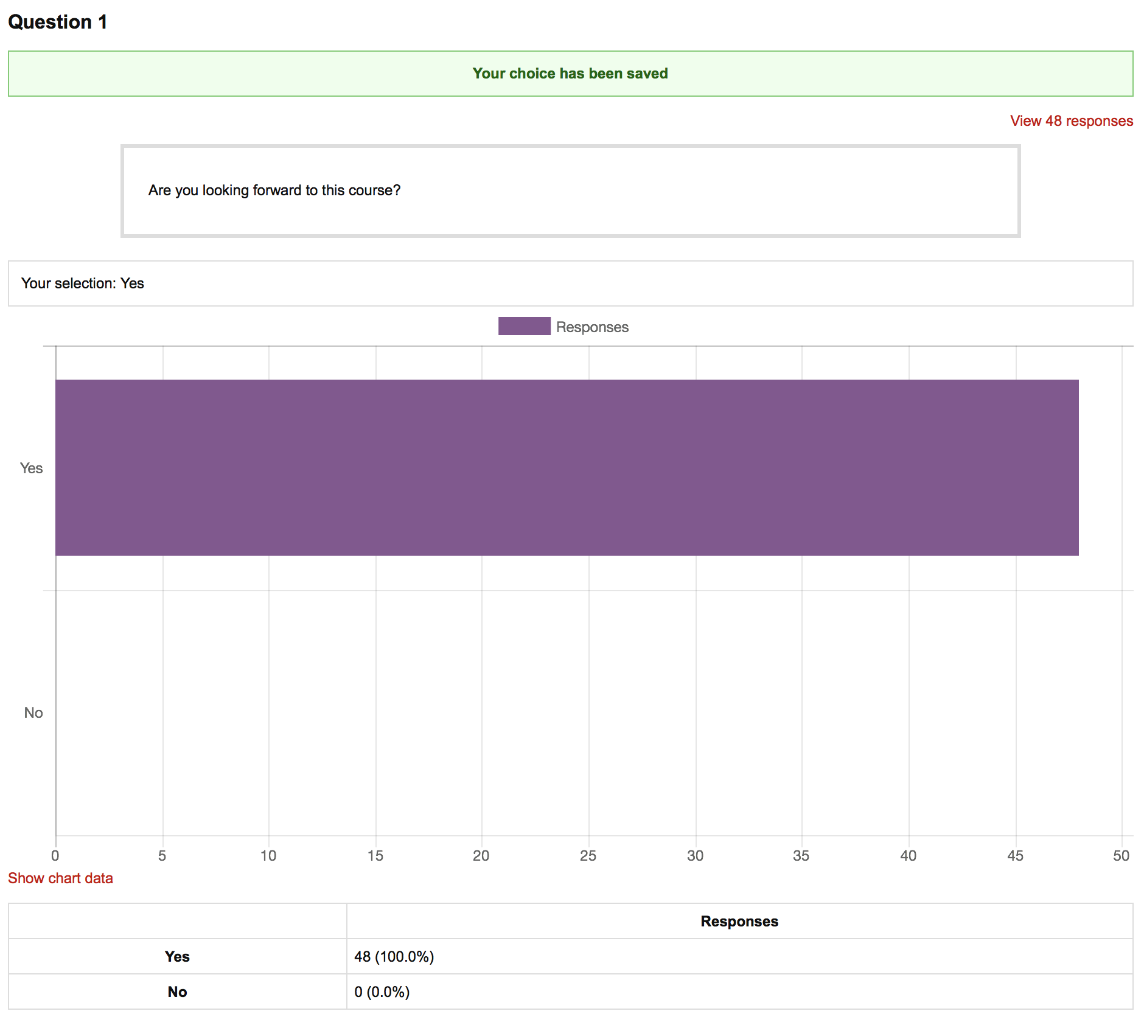
Notes:
Here’s what one looked like.
The question was, “Are you looking forward to this course?”
This was a throw away question in terms of value of answer.
We anticipated that no-one would be willing to say “no.”
We wanted to get people comfortable with the feature in Moodle and see that it really would take only a few seconds to answer.
Plus, once they answered then then they get to see the aggregated results of their classmates,
and see that it was truly anonymous to the learners.

Slide 20
Are You Fasting This Month?
Notes:
The unfortunate timing of this course is during the month of Ramadan.
This fasting during daylight hours was adhered to by some of the learners in Kenya and some in Toronto.

Slide 21
How Many Languages Do You Speak?
Notes:
This was the first question that shifting the information shared away from cliches towards individual capabilities.

Slide 22
How Many Languages Do You Speak?
79%
Multilingual
Notes:
This question was to shine a light on some of the shared skills of the learners in Toronto and Dadaab.

Slide 23
Parents’ Level of Education
Notes:
On separate days we asked about
the fathers’ education level
and then the mothers’.
Here are the results combined.

Slide 24
Parents’ Level of Education
Notes:
By being part of this course,
most of had already exceeded their parents’ education.
This has general resonance with me as many higher education distance learners are the first in their family to pursue HE.

Slide 25
Component of the Redesign
Learner created Wikis for discussing class readings
Transparent.
Collaborative.
“Academically citing” each other in posts.
Rich and meaningful course related content.
Notes:
It was thrilling to watch,
and see the shift in tone to using academic language
to reference each other’s personal posts.

Slide 26
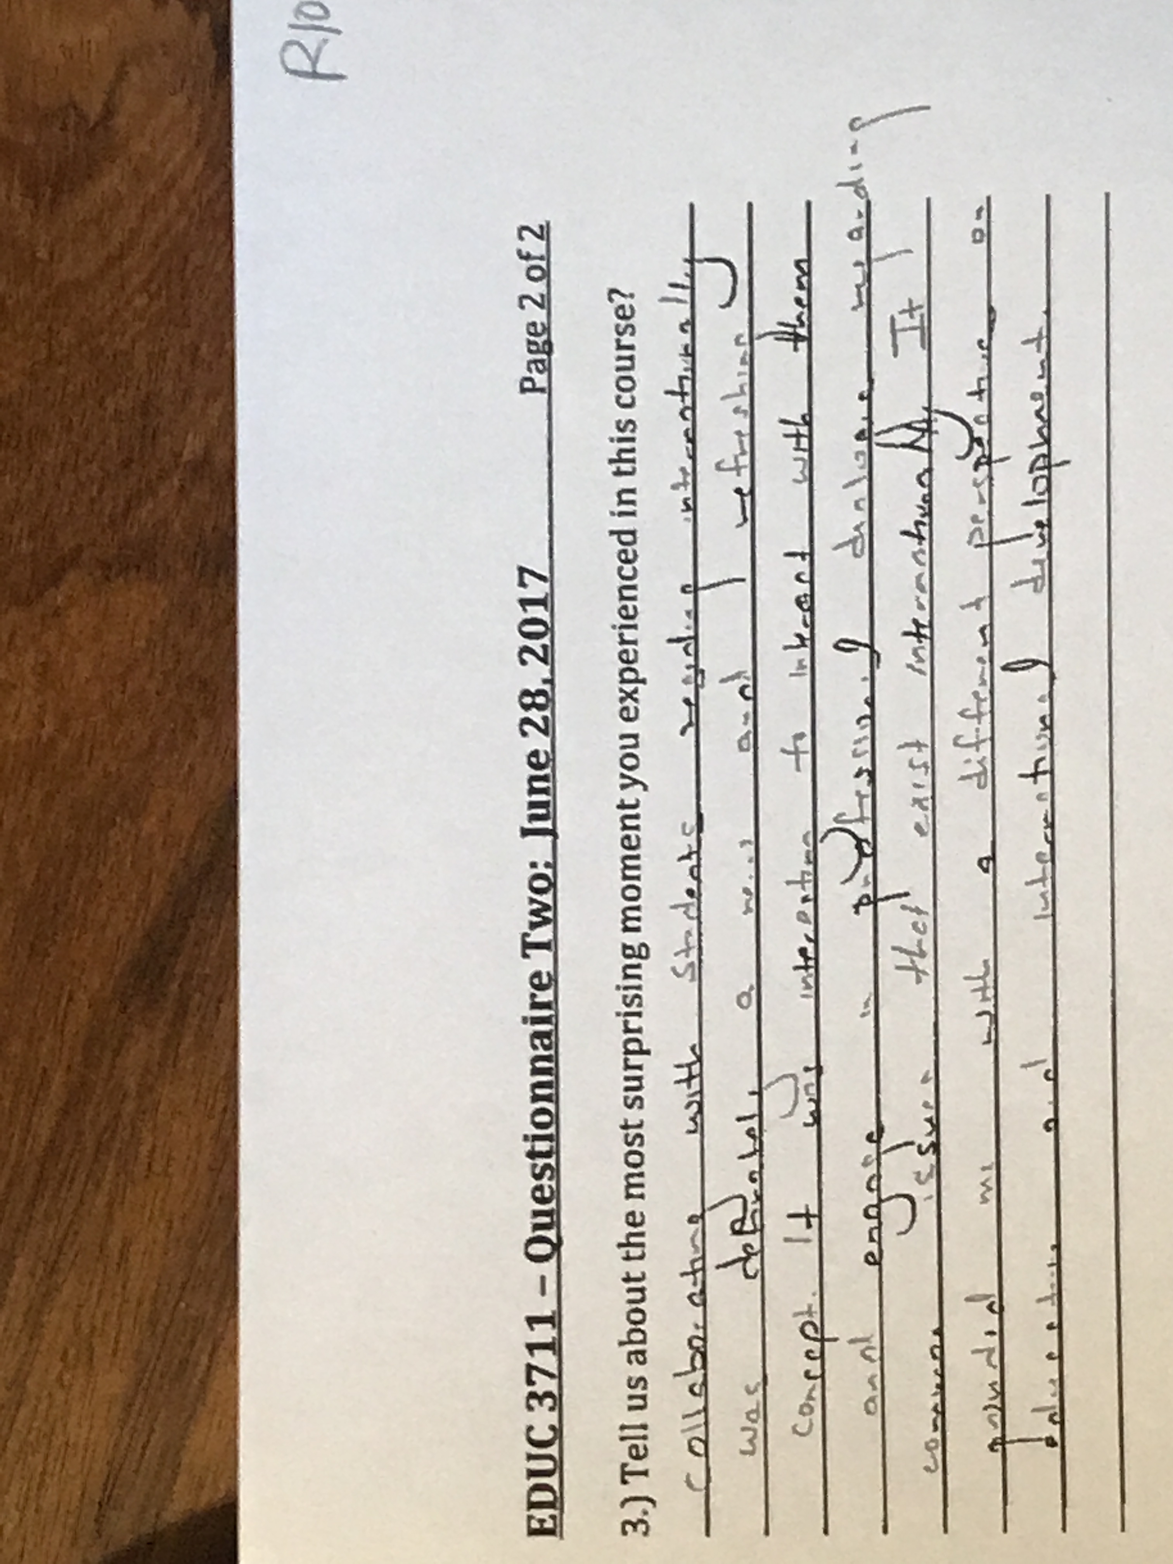
Professional Dialogue
Notes:
This learner wrote, “Collaborating with students regarding internationally was definitely a new and refreshing concept.
It was interesting to interact with them and engage in professional dialogue regarding common issues that exist internationally.
It grounded me with a different perspective on education and international development.”

Slide 27
What do you think is the most important aim of education?
Notes:
Our polls started with a throw away question.
To get everyone comfortable with the format.
We moved to social questions that could highlight the strengths of learners and see similarities with others in the course…

Slide 28
What do you think ought to be the three most important priorities for international development projects?
Notes:
… we then moved to more course related questions
but still holding the position that the polls allow
for the expressions of the respondents’ views
with no right and wrong answer.

Slide 29
In 2030, the social, political, economic, and environmental state of the world will be:
Notes:
In hindsight, it may not have been the wisest thing to have this as the last poll question,
At the end of the course,
When the learners were stressed about group projects, and final papers.
I coloured the sections, to show the pattern,…

Slide 30
In 2030, the social, political, economic, and environmental state of the world will be:
32% Pessimistic
38% Optimistic
29% Neutral
Notes:
which broke down roughly into thirds, positive, negative, and neutral.

Slide 31
Core Design
Higher education.
Across geopolitically diverse multiple sites.
Exploring global concerns.
Valuing diversity.
Promoting social justice.
Challenging the margins of higher education.
Notes:
The core design of the course was strong
and remained unchanged.

Slide 32
Redesign
Multiple opportunities to break down communication barriers.
Heighten peer-to-peer relationships.
Utilizing more features already in moodle.
Adding the use of WhatsApp for online discussions.
Notes:
Our redesign addressed removing a few barriers
(that we perceived)
by providing multiple opportunities
to heighten the learning experience.

Slide 33
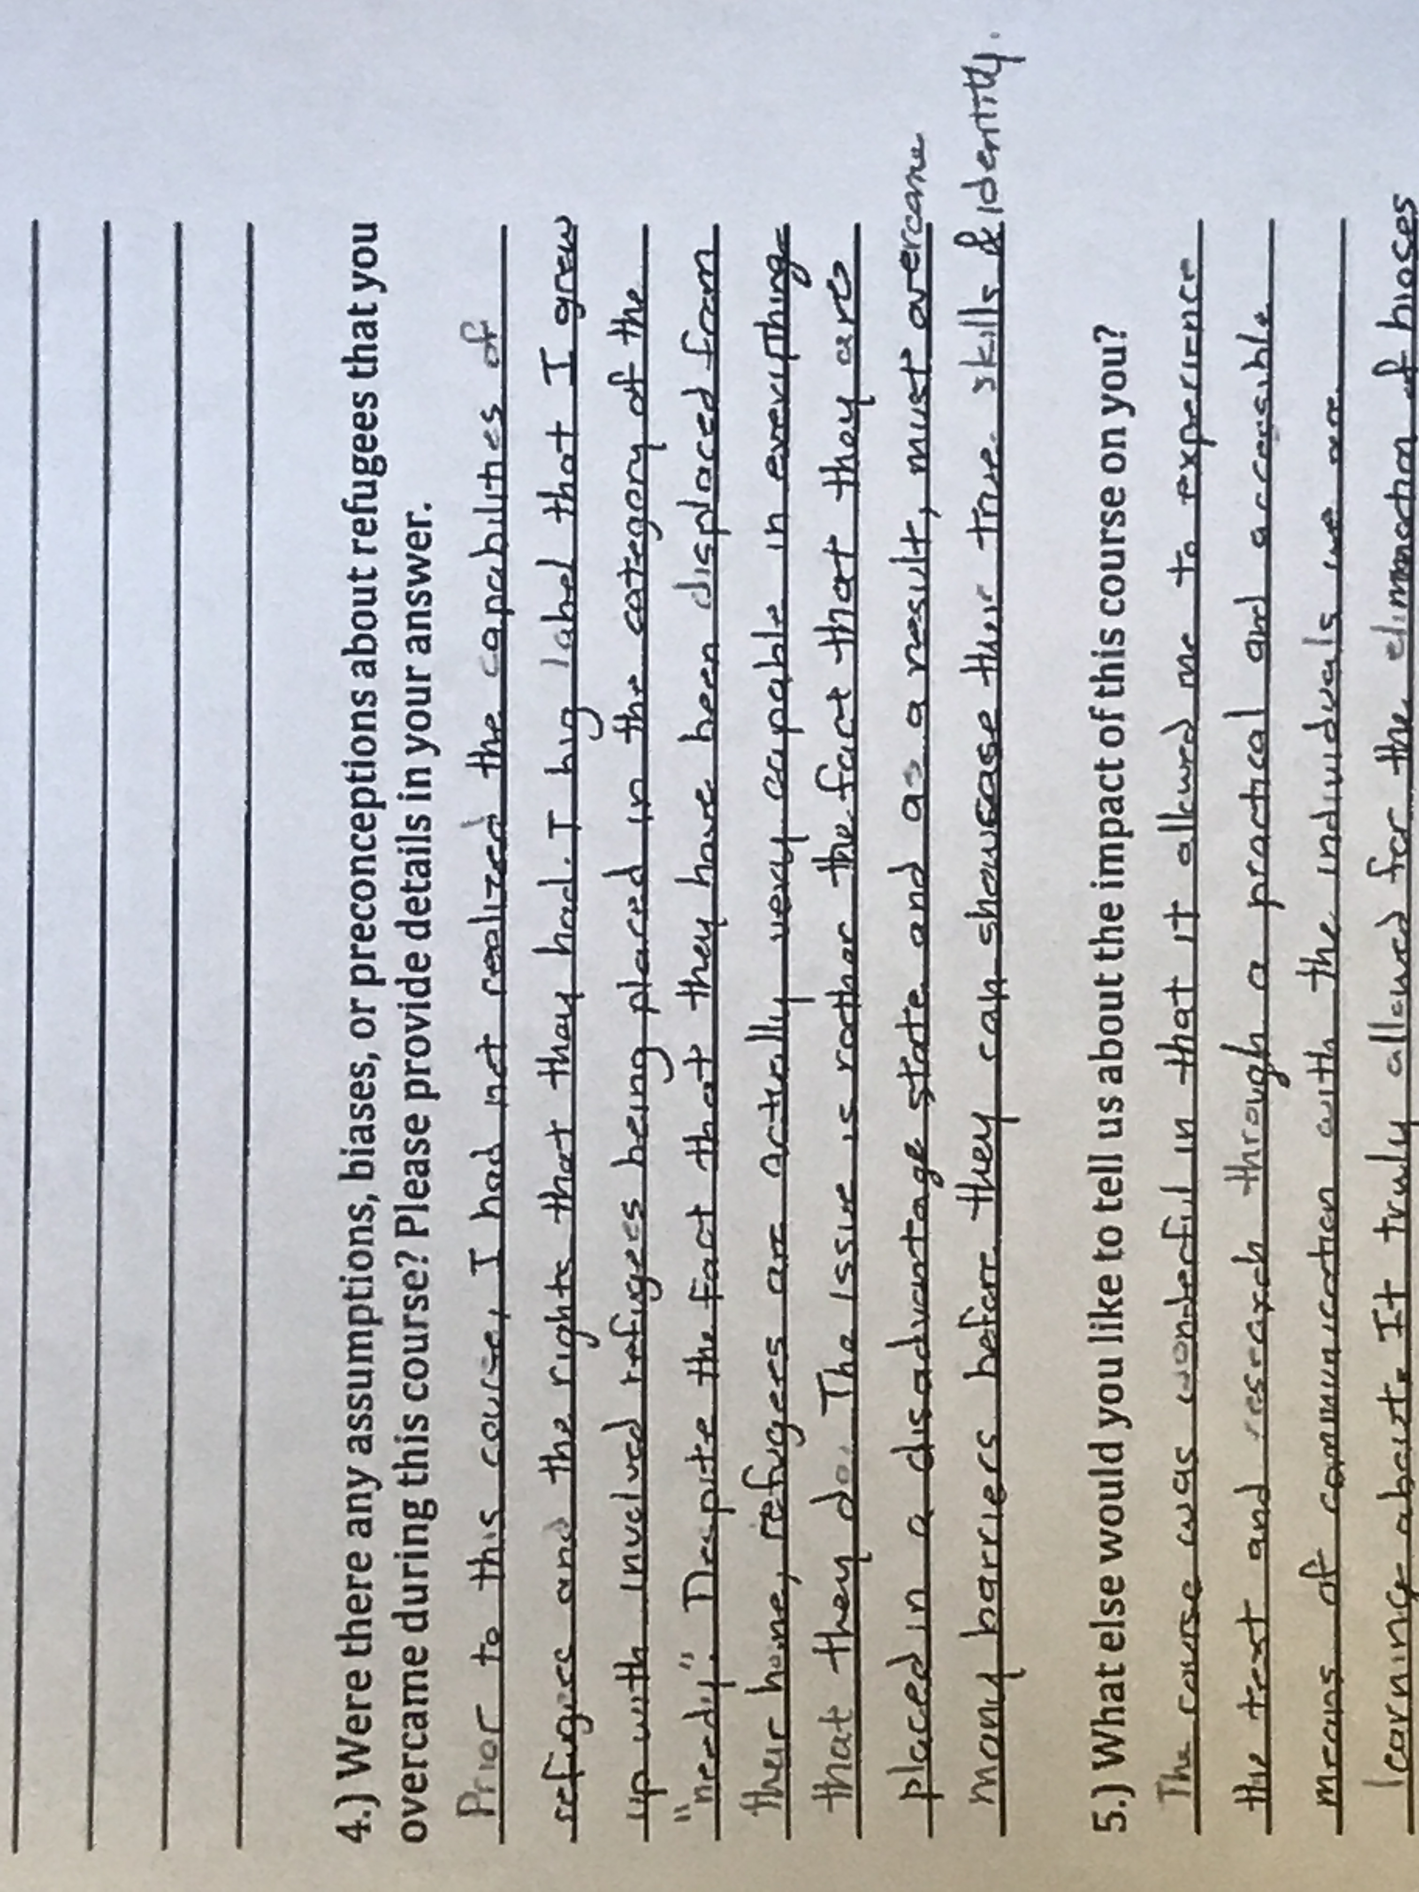
Capabilities and Rights
Notes:
I’ll leave you with this.
The learner wrote of the shift of perspective from seeing refugees in terms of “needy” to seeing them in terms of their capabilities and intrinsic rights.

Slide 34
Thank You
Kerry Doyle
Peggy Lynn MacIsaac

