Slide 1
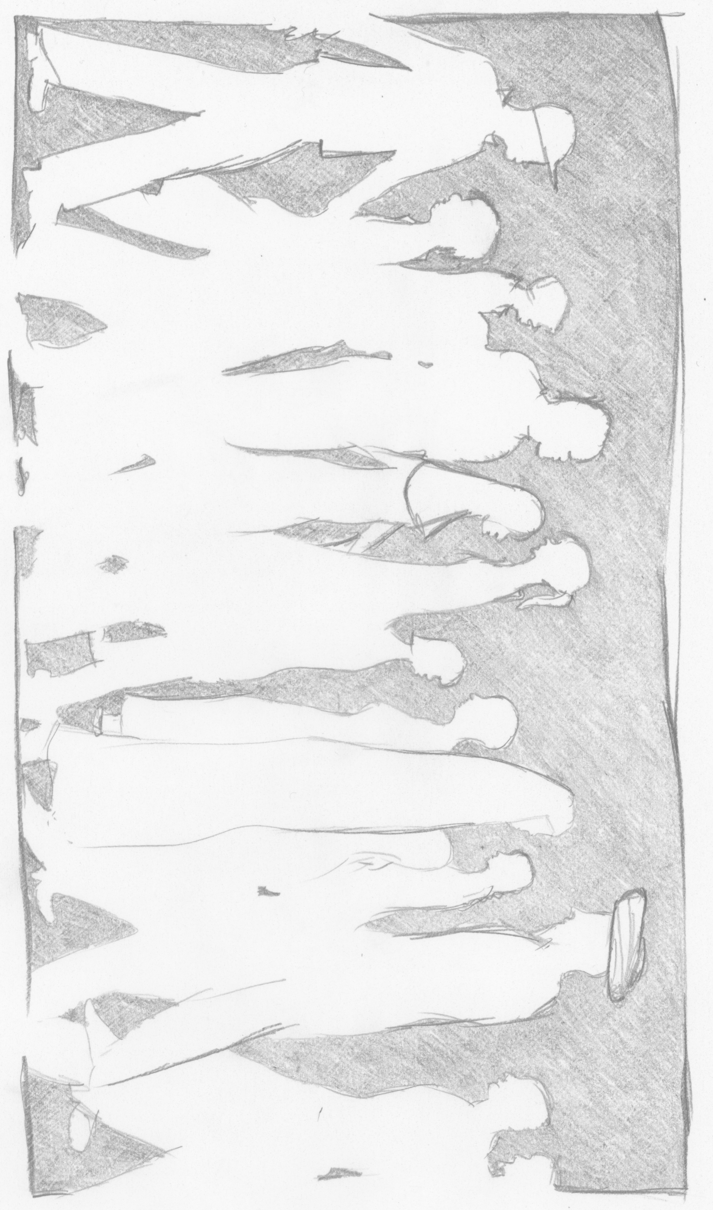
Online communications of multi⁻site blended learning in Toronto Canada and refugee camps in Dadaab Kenya
Peggy Lynn MacIsaac
Borderless Higher Education for Refugees (BHER) via York University
Notes:
Good afternoon, welcome.
I’m Peggy Lynn MacIsaac.
Today’s presentation is based on my work with York University
as a Research Assistant.
By way of introduction, I’ll add that I’m currently a student
in the Doctor of Education
in Distance Education program
at Athabasca University, as well,
I’m work full time for AU as the reference services librarian.

Slide 2
Online communications of multi⁻site blended learning in Toronto Canada and refugee camps in Dadaab Kenya
Communication between learners
Notes:
Communication between learners is important to academic success in online and blended courses.
Achieving meaningful communication in a compressed one-month undergraduate credit course can be difficult.
This process is made even more challenging
when the course is delivered in multiple sites,
internationally across cultures,
and in areas with unequal information and communication technology infrastructures.
This is the context for my presentation, today.

Slide 3
Online communications
of multi⁻site blended learning in Toronto Canada and refugee camps in Dadaab Kenya
The Course.
The Study.
Preliminary results.
Notes:
This afternoon, we’ll take a tour through an in-progress study of
one multi-site blended learning course.

Slide 4
The COURSE

Slide 5
The course
Borderless Higher Education for Refugees (BHER) via York University.
Undergraduate credit course.
EDUC3711 Education and International Development.
Compressed four-week summer term.
Notes:
The course is delivered through
Borderless Higher Education for Refugees
(BHER)
Via York University.
It’s a compressed
four week
credit course.

Slide 6
The Delivery Model
Multi-site blended learning
  Face-to-face.
  Online course using Moodle.
  26 learners from Toronto, Canada.
  25 Learners from a refugee camp in Dadaab, Kenya.
Notes:
The class is split between two sites
Half are in Toronto area, and half from one of two locations in Kenya, Kakuma or Kalobeyei.

Slide 7
Access to the Internet
For Kenyan based learners – once a week, when they travelled to the camp based learning centre.
The Kenyan learners were given iPads, but could not afford data plans.
Notes:
This is the big issue.
The Kenya based learners have access to the internet once a week
when they travel
to the camp-based
learning centre.

Slide 8
Timely Internet communication
Kenyan learners end of day was 4pm Kenyan time on Saturdays.
For the Toronto based teaching team and Toronto based learners this was 9am.
  For the most part, if a learner posted a question using Moodle course communication tools, they would not have access to read the answer until the following Saturday. This is too long a wait in a four week course.
Notes:
To make this more vivid,
For the Toronto based teaching team,
that one day a week at the learning centre in Kenya
Ends
at 9am Saturday morning, Toronto Time.
If a Kenyan based learner posted a question in the course’s learning management system, the learner likely won’t read that response until the following Saturday.
Anecdotally, there hasn’t been much collaboration online through the course learning management system for past courses which have been delivered this way, split between two geographies.

Slide 9
Added WhatsApp
This removed most time limitations for asynchronous communication.
Composition of WhatsApp groups.
  Local discussion groups.
  International group projects.
  All learners and research assistants.
  All the teaching and research assistants.
Notes:
We made several course design changes to encourage greater communication
and ultimately with the hope for greater collaboration between the learners.
One was adding, using WhatsApp mobile chat messaging for online course discussions.
I’ll touch on some of the others in my second presentation on this panel.

Slide 10
The Study

Slide 11
Our Goals
To increase opportunity for communication between learners of the two geographies in the hopes that deep and meaningful learning through collaboration could occur.
To study the development of social presence and learning networks of the learners via online communications.
To respect current research ethics and international standards for education in emergencies.
Notes:
To increase bi-lateral communication,
Between Toronto based learners and the
Kenyan based learners
To study social presence and learning networks as demonstrated through online communications.
To respect current research ethics and international standards for education in emergencies.

Slide 12
Ethics
Tri-council policy statement: Ethical conduct for researching involving humans.
  (Tri-council = Canadian Institutes of Health Research, Natural Sciences and Engineering Research Council of Canada, and Social Sciences and Humanities Research Council of Canada.)
INEE minimum standards for education: Preparedness, response, recovery.
  (INEE= Inter-Agency Network for Education in Emergencies.)
Notes:
These are the two guiding documents:
Tri-council policy statement
And INEE – with is Inter-Agency Network for Education in Emergencies
These standards are a companion document the
SPHERE Project’s
Humanitarian charter and minimum standards in humanitarian response.
INEE focuses on the Education portion of the humanitarian responses.
They are voluntary international standards for humanitarian responses to emergencies.

Slide 13
DEFINITION
Emergency:
  a situation where a community has been disrupted and has yet to return to stability.
Source: Inter-Agency Network for Education in Emergencies. (2010).
INEE minimum standards for education: Preparedness, response, recovery.

Slide 14
Framework
Social Presence as outlined in the Community of Inquiry (COI)
  Social Presence in this study will be defined as the degree to which one projects ones own personality within the online course communications, as measured by indicators for contributing to group cohesion, fostering interactive open communication, and demonstrating personal affect.
(Garrison, Anderson, & Archer, 2010;
Rourke, Anderson, Garrison, & Archer, 1999 )

Slide 15
Framework
Why only one of the three presences?
  Cognitive, teaching and social presences together are necessary for deep and meaningful learning.
  Social presence can be viewed as a progressively developing construct and changing over time within a Community of Inquiry, taking a more prominent role in the beginning and to a lesser extent as cognitive presence develops.
  (Garrison, 2009; Garrison, Anderson, & Archer, 2010).
Notes:
Why study only one of the three presences?
This gets back to one of our goals, to increase online communication
Some view the development of social presence online
to be an necessary communication component
in order to foster
the opportunity
to develop the other two presences.
This was a reasonable place to focus our attention.

Slide 16
Framework
Social Presence indicators
  Have changed slightly overtime and various research projects have included or excluded indicators.
  (Garrison, Anderson, & Archer, 2010)
  For this study, the indicators for interactive communication are modified.
  Because of WhatsApp technical capabilities, two indicators are removed since their coding would be null. “Continuing a thread” and “Quoting from others messages”
  “Expressing disagreement” is included as it is consistent with the importance of expressing disagreement elsewhere in the framework. (Lowenthal & Dunlap, 2014; Swan 2003)
Notes:
The indicators have changed over time
Because WhatsApp’s technical capabilities, two indicators were removed “continuing a thread” And “quoting from other messages”
Others have demonstrated the value of adding an indicator for “expressing disagreement,”
Even in the seminal work on social presence in the COI, Rourke, Anderson, Garrison, and Archer (1999), Describe the expression of disagreement as being “characteristic of those who share strong bonds (p.60).”
Even in the seminal Elsewhere in the COI framework, the expression of disagreement is valued.
Like any social presence indicator, too much or too little can hinder the development of a online community I
in which deep and meaningful learning might occur.

Slide 17
Why study the Posts?
INEE encourages the protection of people in fragile contexts from being “over studied” leading us to want to investigate the posts and not triangulate the data collection with interviews, focus groups, etc.
More importantly, following INEE recommendations, the increase in benefit to the participant who is in an emergency context does not outweigh the burden of increased time to participate.
Notes:
The INEE sets a higher standard of cost/benefit analysis of the burden to participate for a learner in a fragile context.
We chose to study what the learners did in the context of their regular course interactions
and not to ask for their participation in extra activities
that would be desirable to triangulate data in a study, such as interviews, focus groups, etc.

Slide 18
population
42 learners were participants in study
Using a proportion of 0.8235
Confidence level of 95%
Confidence interval of 0.05
Notes:
We had a strong sample size.

Slide 19
Data sample
Study participants were represented throughout all 30 learner WhatsApp groups.
11 of the 30 groups were completely comprised of study participants.
100% of the learner authored chat messages in these 11 groups were studied.
696 messages.
Notes:
Learners were in 30 WhatsApp groups. Two groups each. One was a local discussion group of learners who met in between classes to discuss the readings.
The other was bi-lateral group for the case study group assignment.
Study participants were scattered throughout the groups.
As luck would have it, 11 of these groups were completely comprised of study participants.
For this phase of the study, we used
All the learner authored chat messages
rom these 11 groups.

Slide 20
Data analysis
Unit of measure = one chat message
696 messages
11 indicators
7,656 binary coded data points
2 coders
  coded 100% of these messages
  Compared 15,312 coded data points
Notes:
Here’s how it breaks down.
We employed a negotiated coding method
where each coder,
coded 100% (not a sample) of the 7, 656 messages, separately.
The coding was compared,
and those in disagreement were discussed
with the aim to find a negotiated agreement
on most if not all of the data points.

Slide 21
Intercoder reliability
6769 non-negotiated agreement 88.4%
402 mistakes in coding * 5.3%
488 negotiated agreement 6.4%
7656 Total coded 100 %
* An advantage of negotiated coding “is that it controls for simple errors brought on by inexperience, coder-saturation or misinterpretation”
(Garrison, Cleveland-Innes, Koole, & Kappelman, 2005, p. 3).
Notes:
21The initial comparison accented straight forward mistakes.
Which is an advantage of this method.
The discussion of the final 488 messages was animated,
And highlighted potential limitations of the coders’ skills,
due to cultural nuances of a given written message, or text-speak contraction, or use of emoticon.
We couldn’t really be sure we weren’t making a cultural misstep.
It is unrealistic that two coders may adequately perceive
All the subtleties in chat message communications between diverse participants in this study.

Slide 22
Intercoder reliability
Category | Indicator | Non-negotiated | Negotiated
Affective | AF1 - Emotion | 89% | 100%
 | AF2 - Humor | 99% | 100%
 | AF3 - Self-Disclosure | 85% | 100%
Interactive | IN1 - Chat referring | 81% | 100%
 | IN2 - Questions | 92% | 100%
 | IN3 - Compliments | 92% | 100%
 | IN4 - Agreement | 84% | 100%
 | IN5 - Disagreement | 98% | 100%
Cohesive | CO1 - Using names | 93% | 100%
 | CO2 - Group references | 85% | 100%
 | CO3 - Phatic | 76% | 100%
Notes:
Here’s how it parses out.
It was surprising that “Phatic” was the area of least agreement.
-
--

Slide 23
Coding definition
Phatic
  Phatics
  Salutations
  Communication that serve as a purely social function
  Greetings
  Closures
Notes:
I wouldn’t have guessed that this would be the area of least agreement.
I think it is because the two coders use language differently
and therefore viewed “purely social functions” of language differently.

Slide 24
Preliminary results

Slide 25
Learners’ Social presence
Affective
Interactive
Cohesive
Learner Sent Chat Messages
Time
Notes:
This chart is based on the 174 learner authored chat messages from one group.
The social presence indicators were aggregated into their respective categories in the COI framework, of affective, interactive, or cohesive.
This is the result of the 522 data points plotted over time.
I did this for each of the eleven groups being analyzed and did not find any discernable pattern between groups as of yet. I chose to share this one, today, because it was sizable data set.

Slide 26
Learning network
Category | Indicator
Affective | AF1 - Emotion
 | AF2 - Humor
 | AF3 - Self-Disclosure
Interactive | IN1 - Chat referring
 | IN2 - Questions
 | IN3 - Compliments
 | IN4 - Agreement
 | IN5 - Disagreement
Cohesive | _{CO1 - Using names}
 | CO2 - Group references
 | CO3 - Phatic
Notes:
We wanted to know who talks to whom, and what they say (as coded for social presence).
Here’s where I was going with this.
As all WhatsApp chat messages are one to many relationship, one person posts, and everyone can read it. I pulled out those messages which addressed a specific person in the group.
Then I weighted each message as one of the three categories (cohesive, affective, or interactive 1, 2, & 3 respectively).
This meant
building an algorithm that would generate a fair representation based on the coding of 10 of the 11 indicators.
I eventually dropped out the one indicator for “using names” since that was the basis for inclusion for this initial test of visualizing
since they all equally had it.
“who talks to whom and social presence are they conveying”
-
--

Slide 27
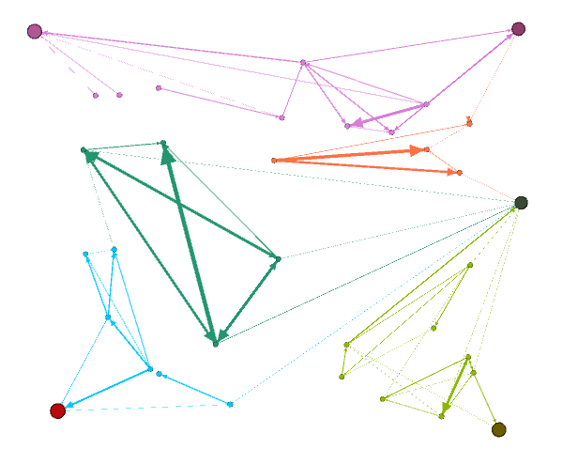
Learner chat messages
Notes:
Unfortunately, my three levels of weighting got rolled into the multiple messages calculation,
and the thickness of the lines in this network aren’t reflecting my weighting alone,
they’re rolled into the visualization of multiple messages between group members.
The five large circles are the five members of the teaching and research team that were in the groups. They’re included if messages were directed to one of them. Their responses to those messages aren’t on this chart.
The colours here are to help differentiate clusters of messages.
As I said at the beginning, this study is in progress.

Slide 28
Closing motivation
Because of current ICT,
  “presence and absence are no longer so strictly spatialized and actualized as near and far, and thus no longer fit so perfectly (if they ever did) with inside and outside.”
(Shields, 2006, p. 235)
Notes:
Because of the current information communication technologies,
“presence and absence
and actualized
are no longer so strictly spatialized
as near and far,
and thus no
with inside and outside“
This is why it’s so cool to me.

Slide 29
Selected Bibliography
Borderless Higher Education for Refugees. (2017). Homepage. Toronto, ON: Author. Retrieved from http://www.bher.org
Canadian Institutes of Health Research, Natural Sciences and Engineering Research Council of Canada, and Social Sciences and Humanities Research Council of Canada. (2014). Tri-Council policy statement: Ethical conduct for researching involving humans. Ottawa, ON: Queen’s Printer.
Carvalho, L. & Goodyear, P. (2014). The architecture of productive learning networks. New York, NY: Routledge.
Castells, M. (2000). The rise of the network society. Malden, MA: Oxford.
Dryden-Peterson. (2011). Refugee education: A global review. Geneva, CH: UNHCR. Retrieved from www.unhcr.org/4fe317589.html
Garrison, D.R. (2009). Communities of Inquiry in online learning. In P. L. Rogers (Ed.) Encyclopedia of distance learning (2nd ed., pp. 352-355), Hershey, PA :IGI Global.
Garrison, D. R. (2017). E-Learning in the 21st century: A community of inquiry framework for research and practice (3rd ed.). London: Routledge/Taylor and Francis.
.

Slide 30
Selected Bibliography
Garrison, D. R., Anderson, T., & Archer, W. (2010). The first decade of the Community of Inquiry framework: A retrospective. The Internet and Higher Education, 13(1-2), 5-9.
Garrison, D.R., Cleveland-Innes, M., Koole, M. & Kappelman, J. (2006). Revisiting methodological issues in transcript analysis: Negotiated coding and reliability. The Internet and Higher Education. 9,1-8.
Inter-Agency Network for Education in Emergencies. (2010). INEE minimum standards for education: Preparedness, response, recovery. New York, NY: Author. Retrieved from http://toolkit.ineesite.org/toolkit/INEEcms/uploads/1012/INEE_GuideBook_EN_2012%20LoRes.pdf
Joksimović, S., Gašević, D., Kovanović, V., Riecke, B. E., & Hatala, M. (2015). Social presence in online discussions as a process predictor of academic performance. Journal of Computer Assisted Learning, 31(6), 638-654. doi:10.1111/jcal.12107
Jones, C. (2015). Networked learning: An educational paradigm for the age of digital networks. New York, NY: Springer.

Slide 31
Selected Bibliography
Lowenthal, P. R., & Dunlap, J. C. (2014). Problems measuring social presence in a Community of Inquiry. E-Learning and Digital Media, 11(1), 20-31.
MacIsaac, P.L. (2017, March 27). Diaspora higher education: What’s next for displaced learners? Interpretations Blog-- Journal of Interrupted Studies, Oxford. UK: University of Oxford. Retrieved from http://blog.jis-oxford.co.uk/2017/03/27/diaspora-higher-education-whats-next-for-displaced-learners/
Moser-Mercer, B. (2014). MOOCs in fragile contexts. In U. Cress, & C.D. Kloos (Eds.) Proceeding of the European MOOCs Stakeholders Summit (pp. 114-121). Lausanne, CH. Retrieved from http://www.emoocs2014.eu/sites/default/files/Proceedings-Moocs-Summit-2014.pdf
Rourke, L., Anderson, T. Garrison, D. R., & Archer, W. (1999). Assessing social presence in asynchronous, text-based computer conferencing. Journal of Distance Education, 14(2), 51-70.
Shea, P., Hayes, S., Vickers, J., Gozza-Cohen, M., Uzuner, S., Mehta, R., & ... Rangan, P. (2010). A re-examination of the community of inquiry framework: Social network and content analysis. The Internet and Higher Education, 13, 10-21. doi:10.1016/j.iheduc.2009.11.002

Slide 32
Selected Bibliography
Shelton, B.E. Hung, J., Lowenthal, P.R. (2017). Predicting student success by modeling student interaction in asynchronous online courses. Distance Education, 38(1), 59-69. doi:10.1080/01587919.2017.1299562
Shields, R. M. (2006). Boundary-thinking in theories of the present the virtuality of reflexive modernization. European Journal of Social Theory, 9(2), 223. doi:10.1177/1368431006063342
Sphere Project. (2011). The Sphere Project: Humanitarian charter and minimum standards in humanitarian response. Rugby, UK: Practical Action Publishing. Retrieved from http://www.sphereproject.org/handbook/
Swan, K. (2003). Developing social presence in online course discussions, in S. Naidu (Ed.) Learning and teaching with technology: Principles and practices, pp. 147-164. London: Kogan Page.
Swan, K. & Shih, L. F. (2005). On the nature and development of social presence in online course discussions, Journal of Asynchronous Learning Networks, 9(3), 115-136.
United Nations High Commissioner for Refugees. (2016). Global trends: Forced displacement in 2016. Geneva, CH: Author. Retrieved from http://www.unhcr.org/globaltrends2016/
Acknowledgement: All drawings in presentation are by Peggy Lynn MacIsaac.

Slide 33
Illustrations by Peggy Lynn MacIsaac
Notes:
My twitter and email.
I’ll turn it over to the panel.

Slide 34
Thank you
Peggy Lynn MacIsaac
@PLmacisaac
macisaac@athabascau.ca
Notes:
My twitter and email.
I’ll turn it over to the panel.

