Slide 1
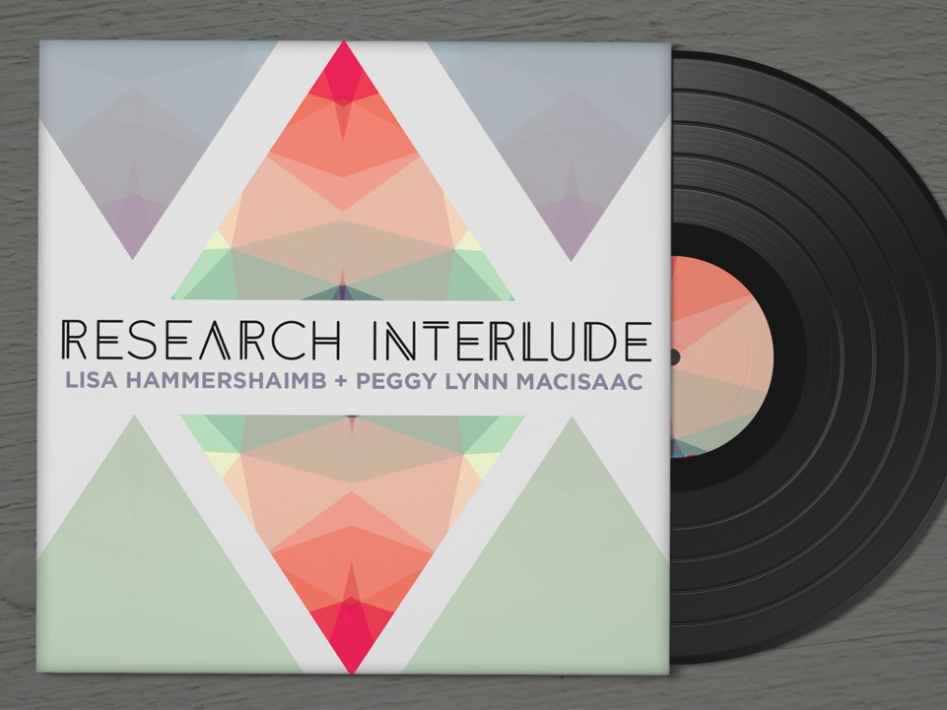
Notes:
Peggy Lynn: Hi. Thanks for that introduction. I’m Peggy Lynn, and online is Lisa.
LISA: Hi + Welcome.
The PowerPoint speaking notes will have our contact information as well as all the citations and source links for this presentation.
Our contacts:
Lisa
Email lisa.hammershaimb@gmail.com
Facebook Lisa Hammershaimb
Website http://www.pixelsandtweed.com
Twitter @merryspaniel
Peggy Lynn
Email macisaac@athabascau.ca
facebook Peggy Lynn MacIsaac
Twitter @PLmacisaac

Slide 2
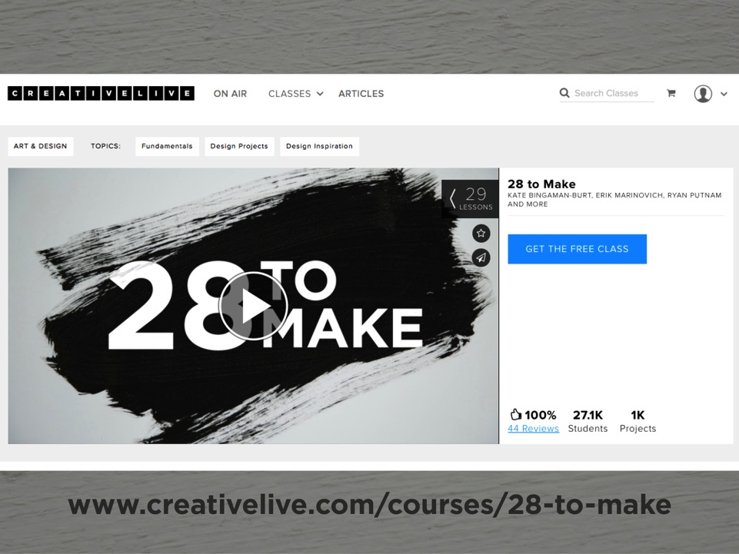
Notes:
LISA: In February of this year Peggy Lynn and I were part of something that might loosely be called a MOOC-for-creativity known as 28tomake. Basically 28tomake consists of daily 20-ish minute creativity igniting activities designed to spark (or re-ignite) a habit of creativity by actively making time in your day for making. Each day you receive a short video prompt which outlines the challenge and when you are finished with your piece, you’re encouraged to upload it using a designated hashtag so you can share and be supported by a worldwide community of creators.
Source: https://www.creativelive.com/courses/28-to-make?via=banner

Slide 3
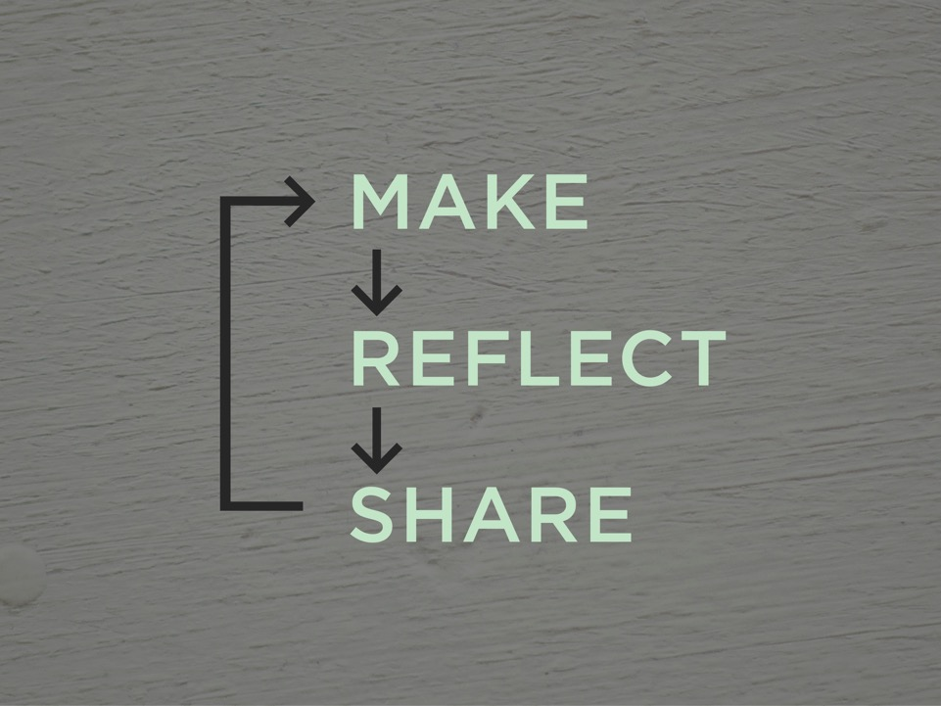
Notes:
LISA: By intentionally engaging in the an iterative cycle of making, reflecting, and sharing with a large community, it was hoped that 28tomake could build a creative habit amongst its participants and energize or re-energize people.

Slide 4
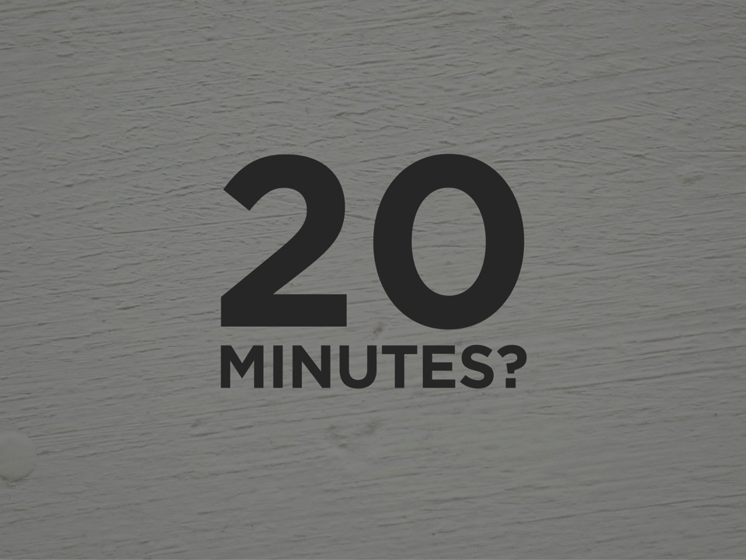
Notes:
LISA: Why 20 minutes?

Slide 5
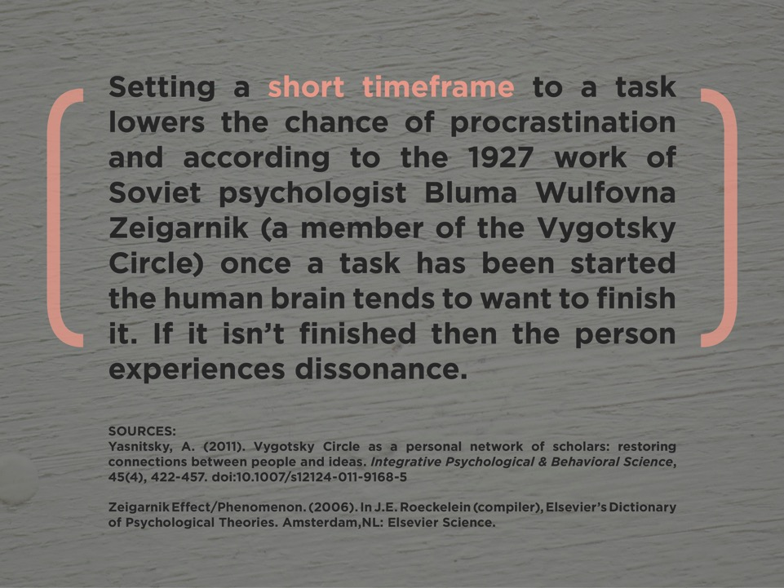
Notes:
LISA and PEGGY LYNN: Because Bluma is AWESOME.
BLU’ ma
WOLF’ phona
Zay GAR’nick

Slide 6
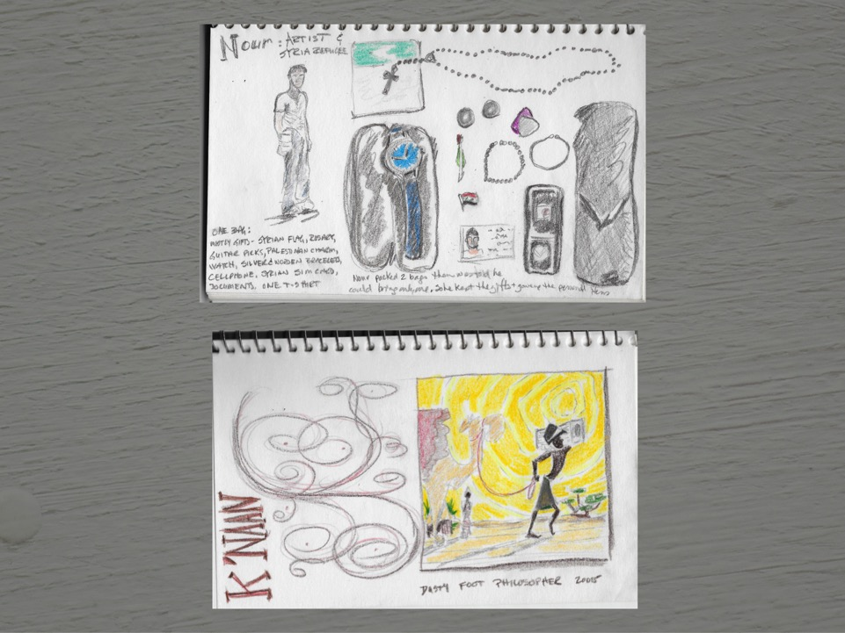
Notes:
LISA: Here are some examples.
PEGGY LYNN: One of the 24 to Make exercises was to draw what was in your bag. I shifted this to wonder if I could do something related to my research on refugees, and I came across a photo exhibit comprised of photo pairs. One was a portrait of a refugee with his or her bag, the other was a single shot documenting the contents of the bag. Each was accompanied by rich stories about the importance of the possessions. I drew Nour, who is an artist and current refugee.
Another exercise was to draw our favorite album cover, so I found the Canadian musician K’Naan who blends his experiences as a refugee into his political musical work.
These short exercises introduced me to some the deeply personal stories from refugees..

Slide 7
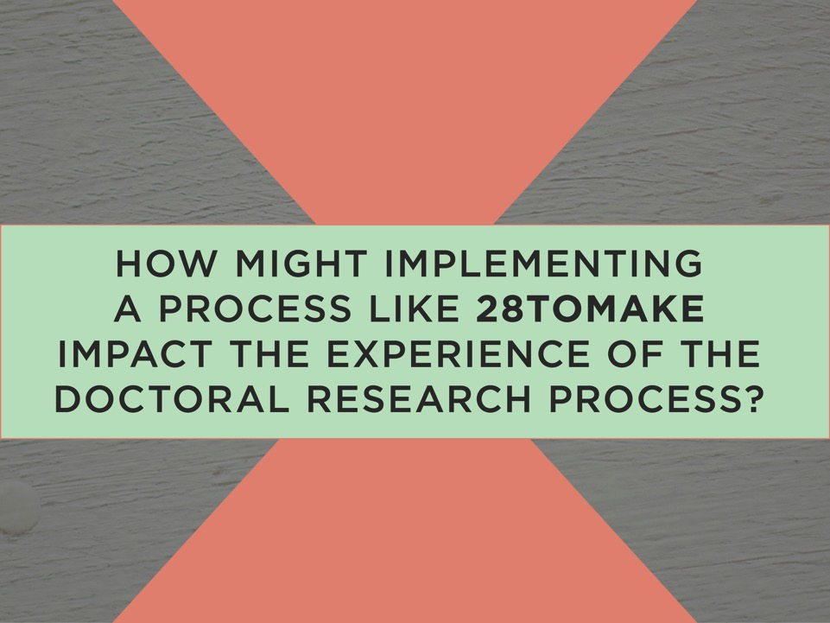
Notes:
LISA: As you can see, by making things, Peggy Lynn has begun to see the world in new ways/be more aware of her own research topics.
In light of these revelations, we and began to wonder if there would be a way to translate the 28tomake ethos into our own dissertation work. We’re both at the point where we’re almost-but-not-quite settled into research topics and our proposals are almost-but-not-quite put together…basically we’re in an inbetween time where sometimes motivation is hard to find.
So...we put our heads together and began to brainstorm ways we could create some quick, engaging, creativity-sparking ideas for our own research.
These practices are designed to get your thinking, give you some new ideas, or maybe just get you re-excited about your work wherever you might be.

Slide 8
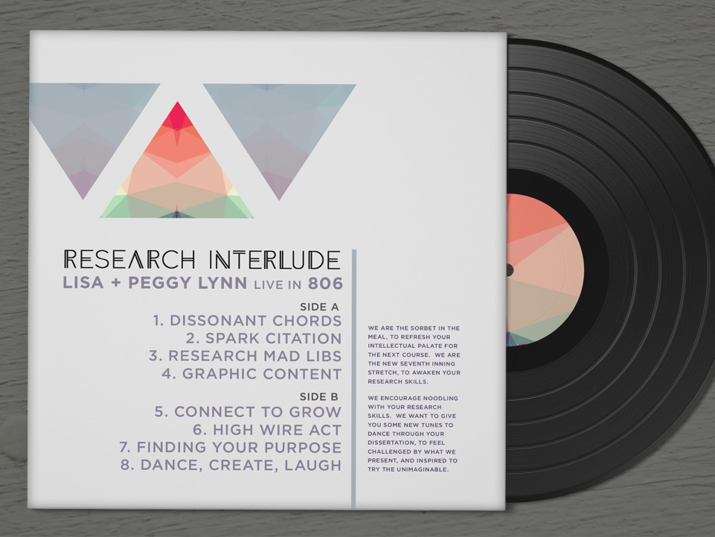
Notes:
LISA: And of course...as our initials are L+P, Peggy Lynn made the brilliant connection to actual LP’s and thus the Research Interlude album was born!
During the spring term of 806: Doctoral Research Seminar, we introduced several practices, encouraged our classmates to engage in them, and finally share publicly on the Athabasca Landing.
Here you can see an assortment of “tracks” we developed. We will be overviewing three tracks in this presentation and as the Research Interludes are meant to be experienced, we are also going to engage in a group activity

Slide 9
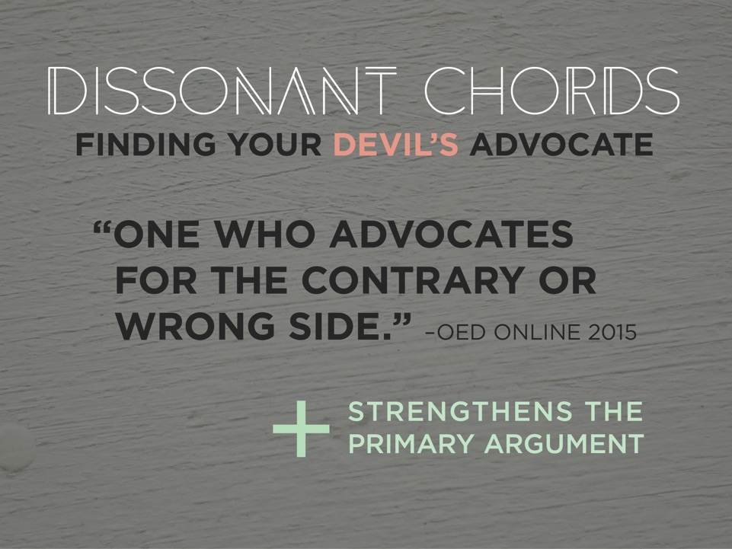
Notes:
LISA: Intro this idea.
Peggy Lynn will demonstrate how this can be done.
Source:
Devil’s advocate. (2016). Oxford English Dictionary Online. http://0-www.oed.com.aupac.lib.athabascau.ca/view/Entry/51468?redirectedFrom=devil%27s+advocate&#eid6864216

Slide 10
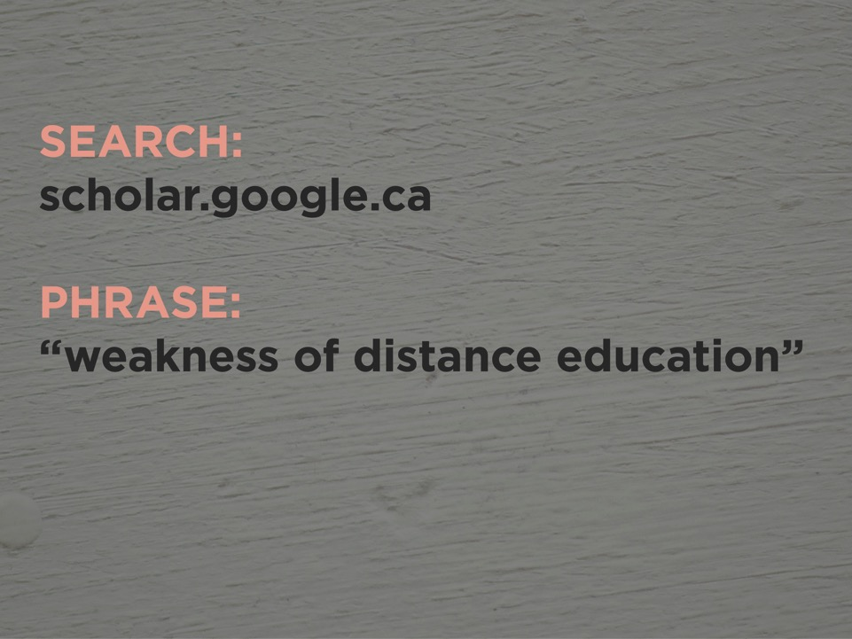
Notes:
PEGGY LYNN:
For this example, let’s imagine you’re a researcher working in the area of distance education.
We’re going to choose to do this simple search in google scholar.
We’ll use the quotation marks to ensure we find this exact phrase.

Slide 11
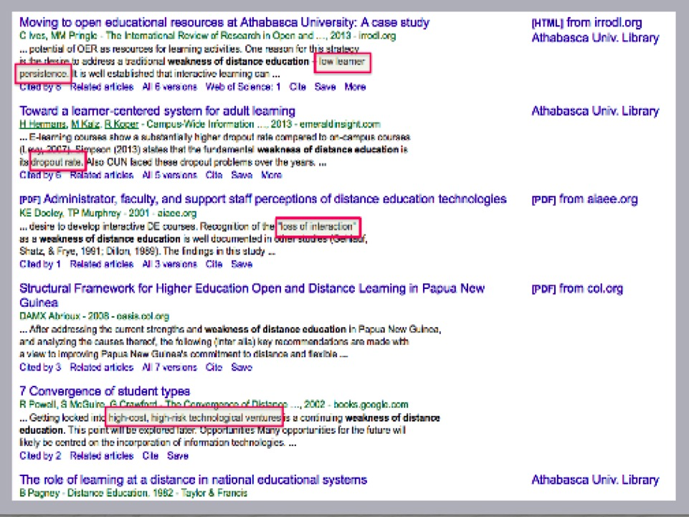
Notes:
PEGGY LYNN:
Reading through the list of results we find good oppositional concepts.
Spend the time paging through the results list without opening any individual item on the list.
This is an expedient way to garner a broad scope of concepts.

Slide 12
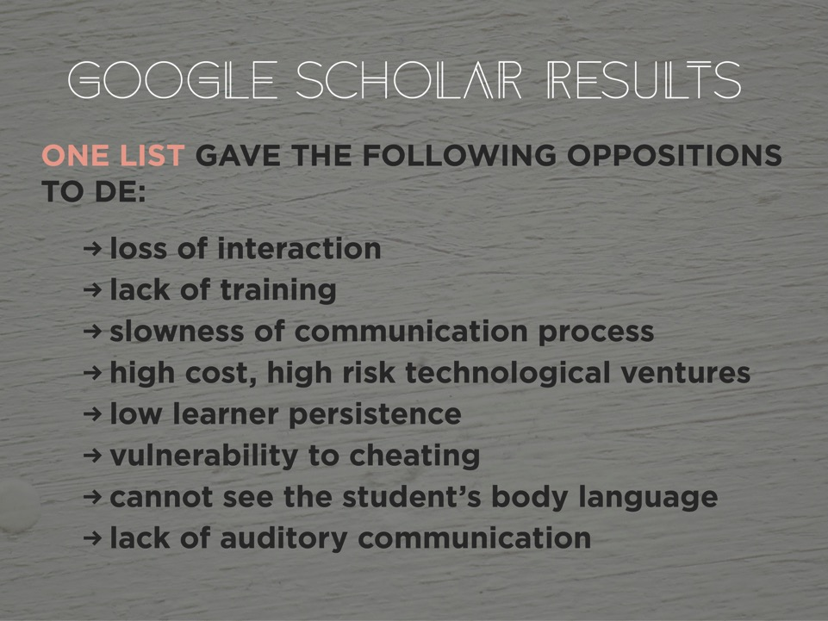
Notes:
PEGGY LYNN: Within a few minutes we can compose a list of oppositions to distance education.
Our suggestion is to select some that would be relevant to your research, and then incorporate and refute them in your work. Use them as a foil to reflect the strength of distance education.

Slide 13
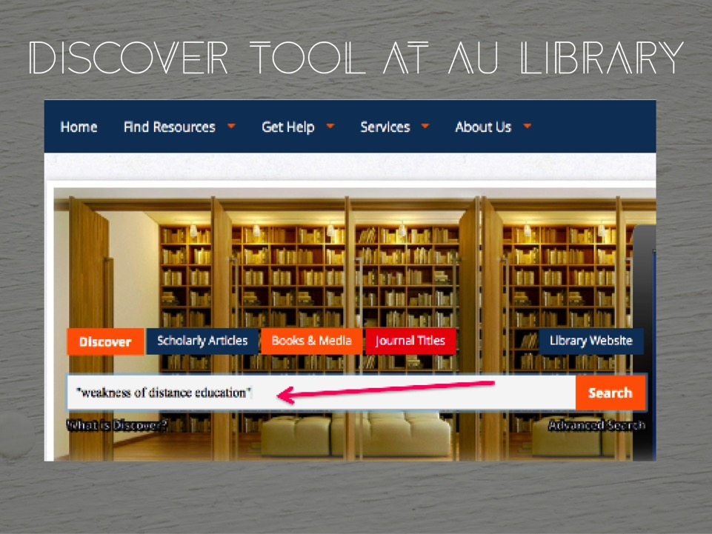
Notes:
PEGGY LYNN: I would be remiss as an Reference Librarian at AU Library if we didn’t suggest you can try this in the Discover search tool at AU Library.
Lisa’s going to take us through our next exercise.

Slide 14

Notes:
LISA: Crafting a good research question is challenging. So we devised an exercise to bring fun into the process of getting used to to the components needed. This is a mash up between Creswell’s suggested template for constructing a research question and the word play game Mad Libs which was co-created by Leonard Stern and Roger Price in 1953.
Source: Creswell, J.W. (1994). Research design: Qualitative and quantitative approaches. Thousand Oaks, CA: Sage Publications.

Slide 15
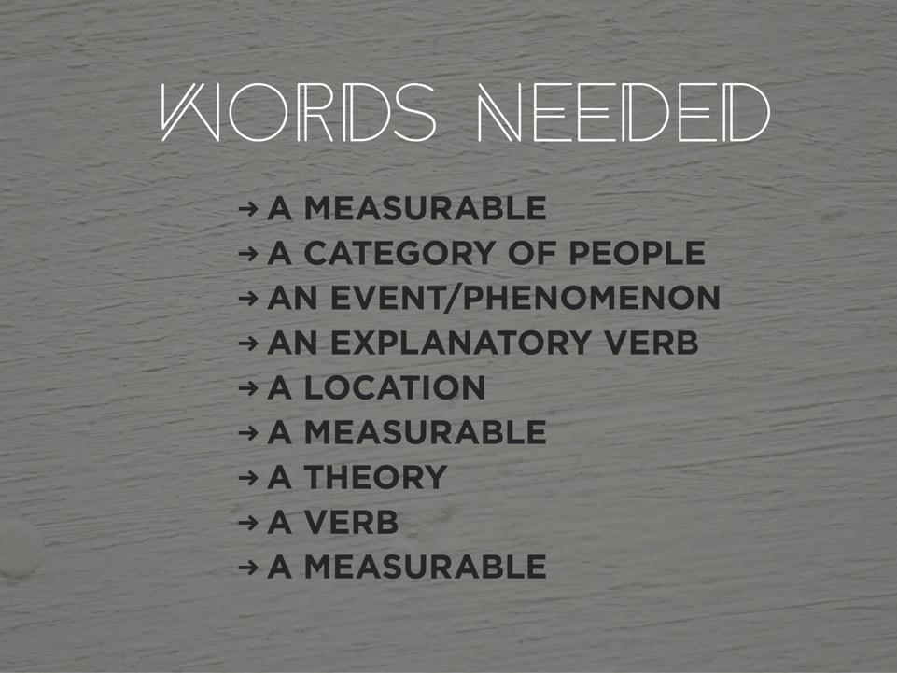
Notes:
LISA: The first step is to list a word or phrase for each of these. The game is in composing this list blindly without knowing how they’ll be used.

Slide 16
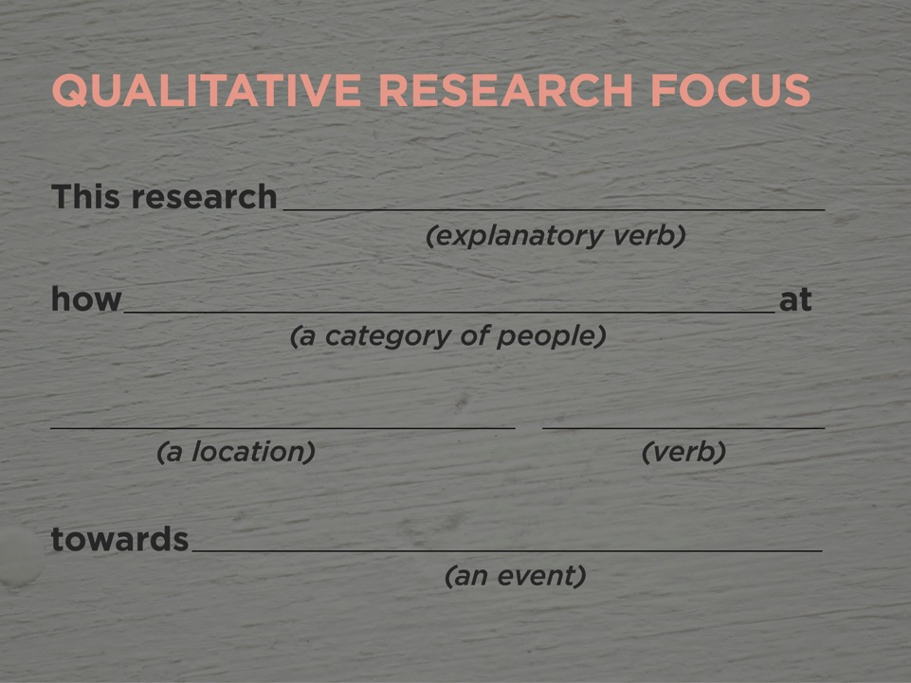
Notes:
LISA: Then place them in the corresponding spaces. One is for Qualitative research.

Slide 17
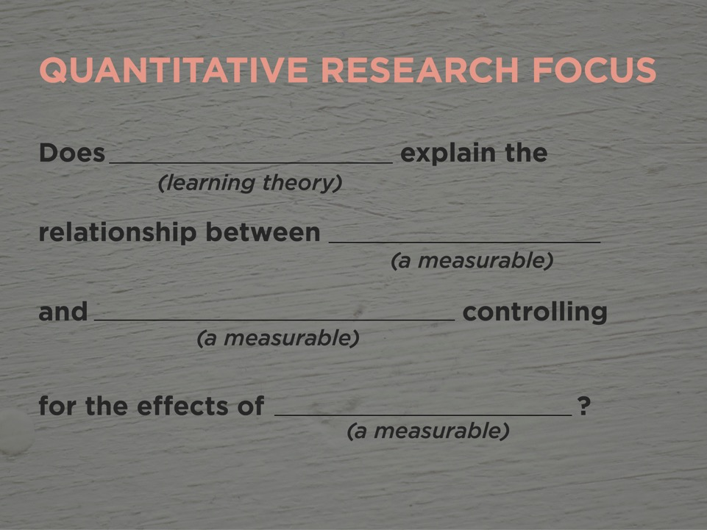
Notes:
LISA: The other for Quantitative. Then read them. They’re fun! And funny!

Slide 18

Notes:
PEGGY LYNN: there are so many benefits to clearly defining your purpose.

Slide 19
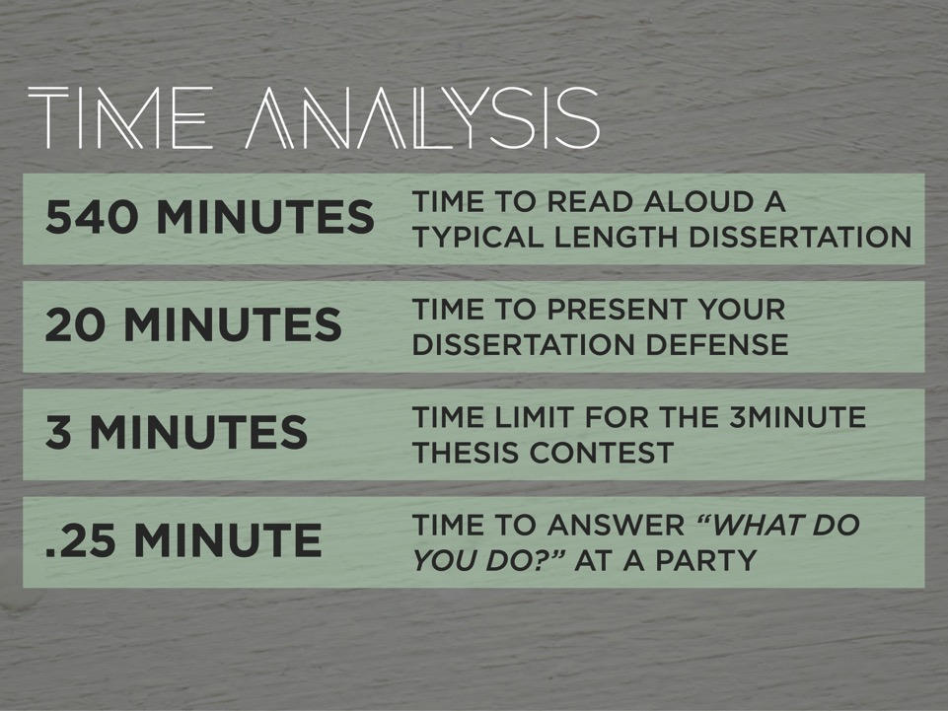
Notes:
PEGGY LYNN: We like this comparison.
9 hours to read aloud a dissertation
20 minutes for your defense
I will say that Lisa successful condensed her research into three minutes to win second place in this year’s 3 Minute Thesis contest.
We’re here to help you distill this even further to answer in 15 seconds the typical social question about your research, “What do you do”?

Slide 20
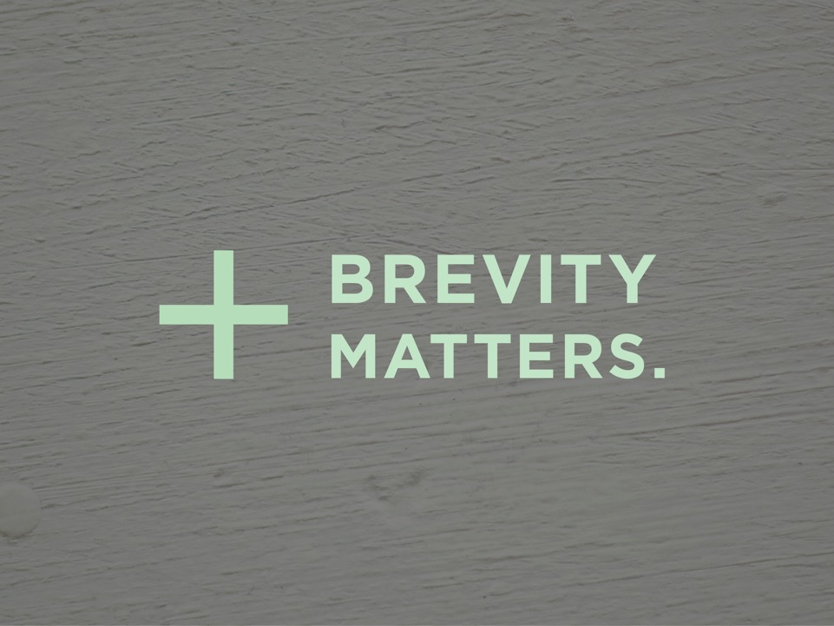
Notes:
PEGGY LYNN: Brevity Matters

Slide 21
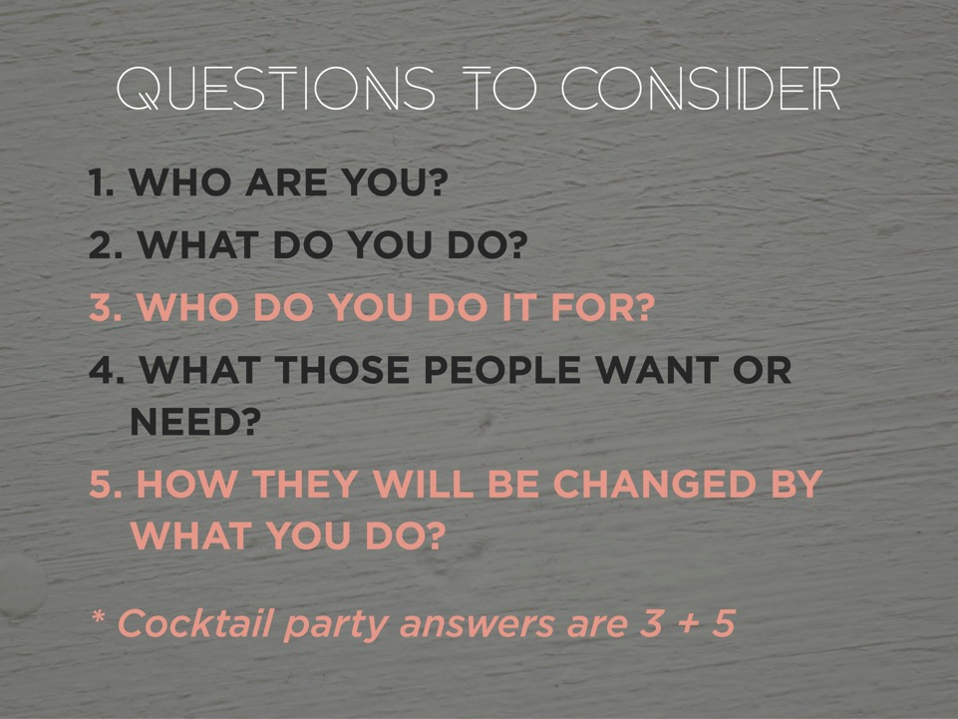
Notes:
PEGGY LYNN: These are adapted from Adam Liepzig’s video called “Finding your life purpose in 5 minutes”
Source: https://www.youtube.com/watch?v=vVsXO9brK7M
We’re going to invite you to work through these questions. You may want to start to jot down your answers. We will post these questions again when we ask for your feedback. I’ll spend a bit of time on these now.
Read them.

Slide 22
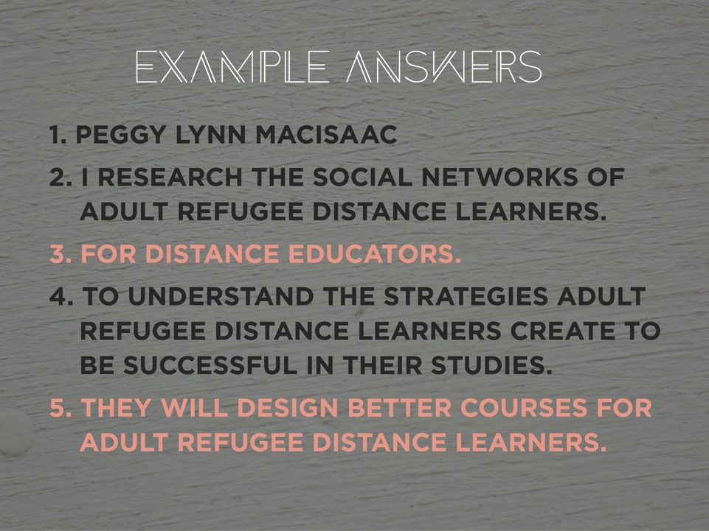
Notes:
PEGGY LYNN: Here’s how I’d answer the questions.

Slide 23
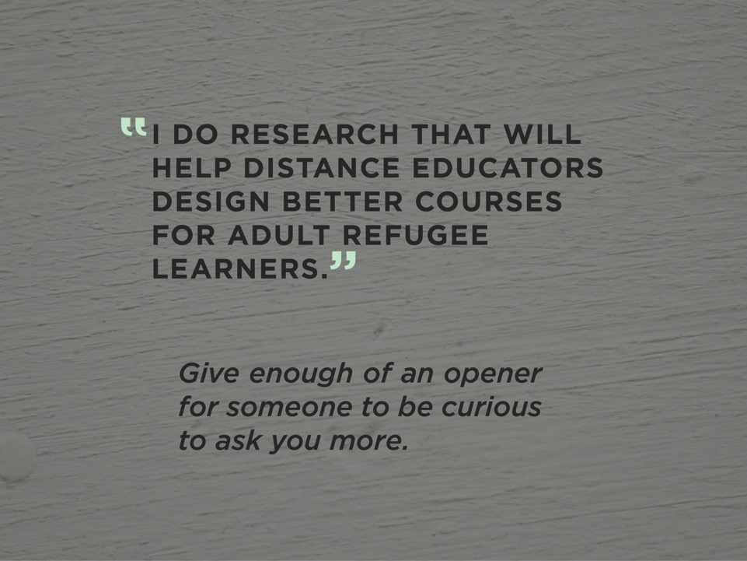
Notes:
PEGGY LYNN: …which distills to this.

Slide 24
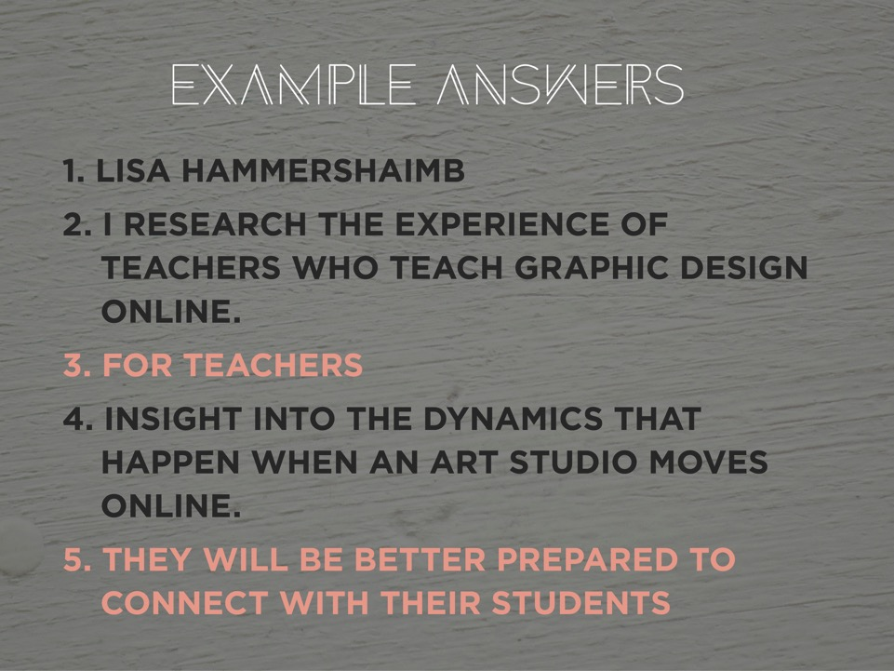
Notes:
LISA:

Slide 25
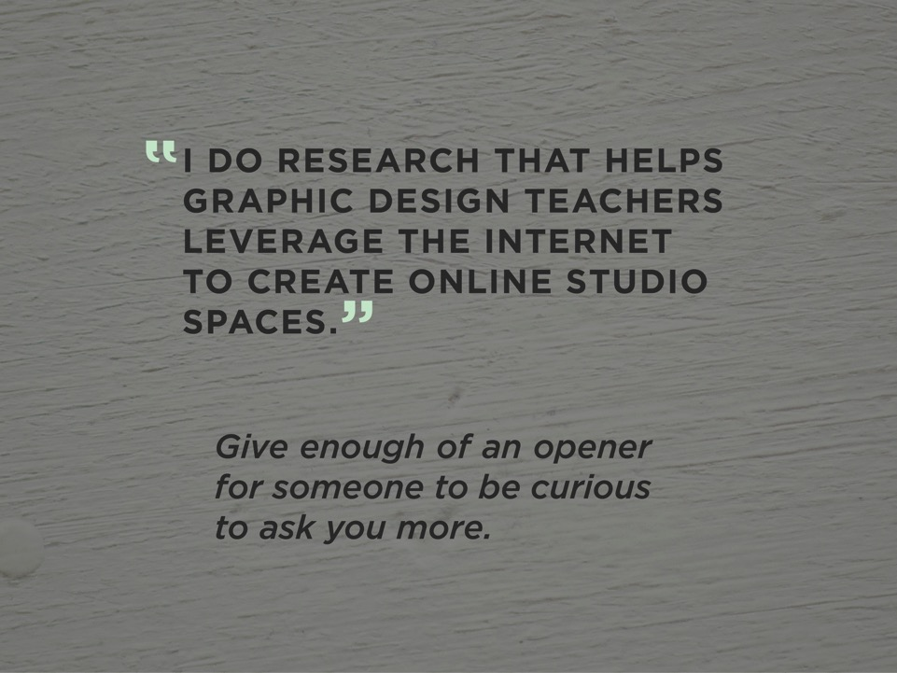
Notes:
LISA:

Slide 26
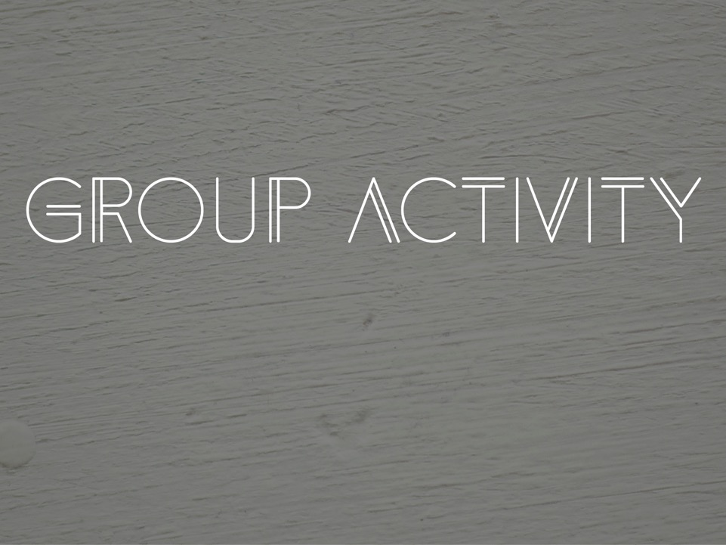
Notes:
LISA: I’ll pass it back to Peggy Lynn to lead this in person.
Peggy LYNN: This bonus to doing this exercise is that it is a reminder of why your research matters.
It’s pretty powerful, and encouraging.

Slide 27
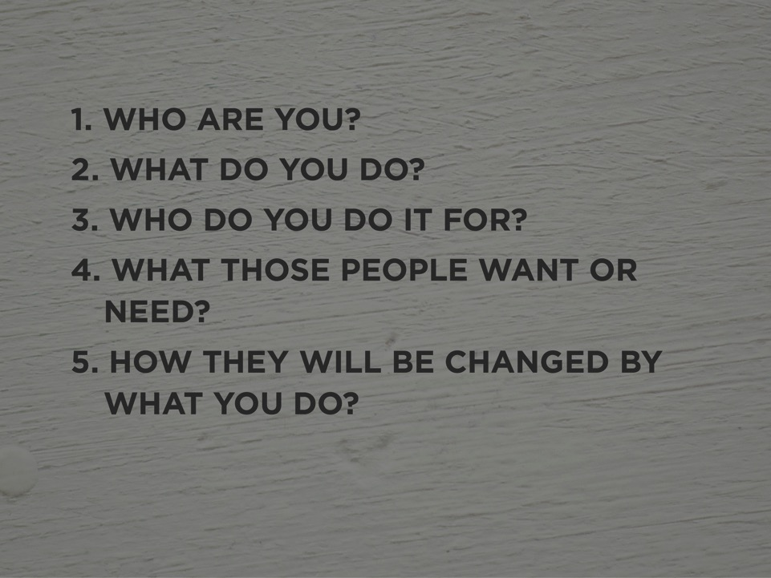
Notes:
PEGGY LYNN: We challenge you to work through these here… today… out loud
I’ll ask the question one at a time and everyone say them out loud at the same time.
So let me ask “ who are you?” Everyone say the answers out loud together, who are you? 1, 2, 3, Pause. Okay.
Next question, What do you do? 1 , 2, 3 Pause. Great. I think we heard more voices.
Really important one. “Who do you do it for?” 1, 2, 3 Pause. Awesome.
“What do these people want or need?” 1,2,3 Pause. Good.
The clincher. “How will they be changed by what you do?” 1, 2., 3
We’’ll give you a moment to craft the cocktail party answer to “tell me about your research?” or “what do you do?” We bet you’ll be using it this weekend.
Does anyone what to stand up and share there cocktail party answer. Great. I’ll start with you. Tell us about your research. Anyone else?
I’ll pass the last word to Lisa.

Slide 28
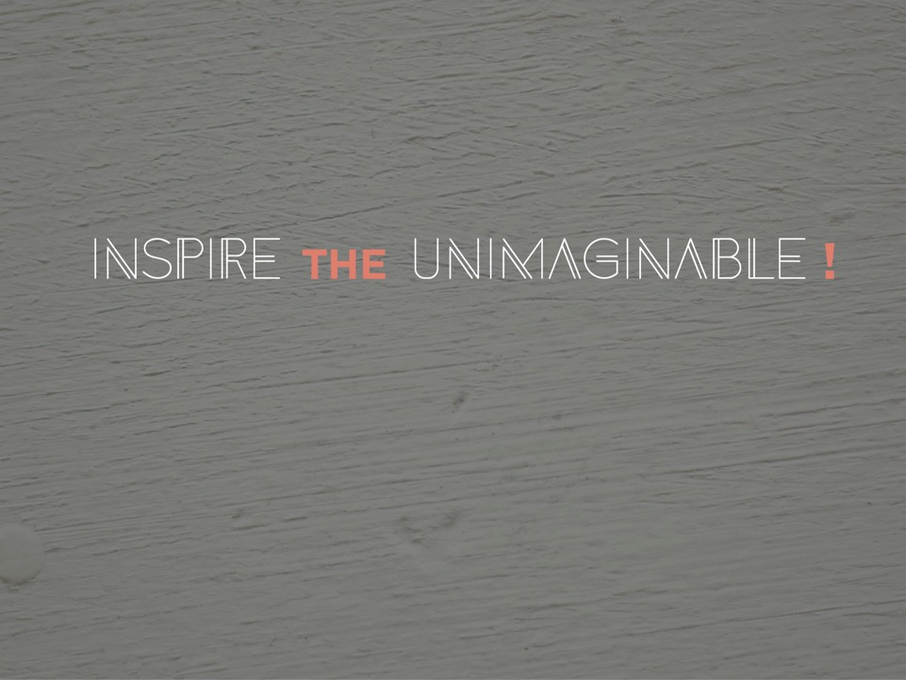
Notes:
LISA: This is “our” purpose.

